Slide 1
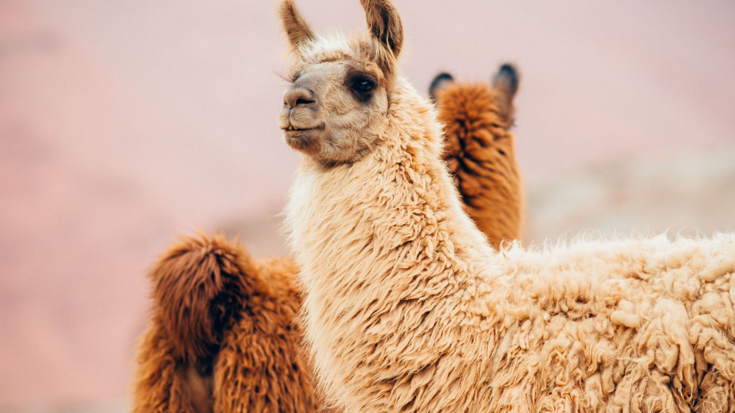
Paleogenomics of Llamas and Alpacas in the Atacama Desert
Conor O’Hare

Slide 2
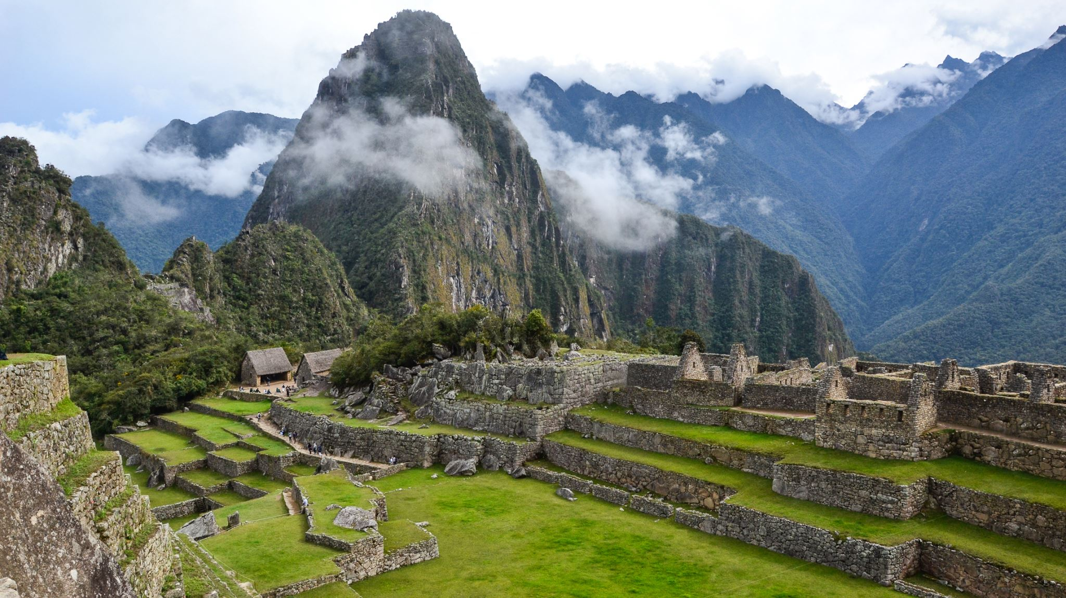
Pre-Columbian south america

Slide 3
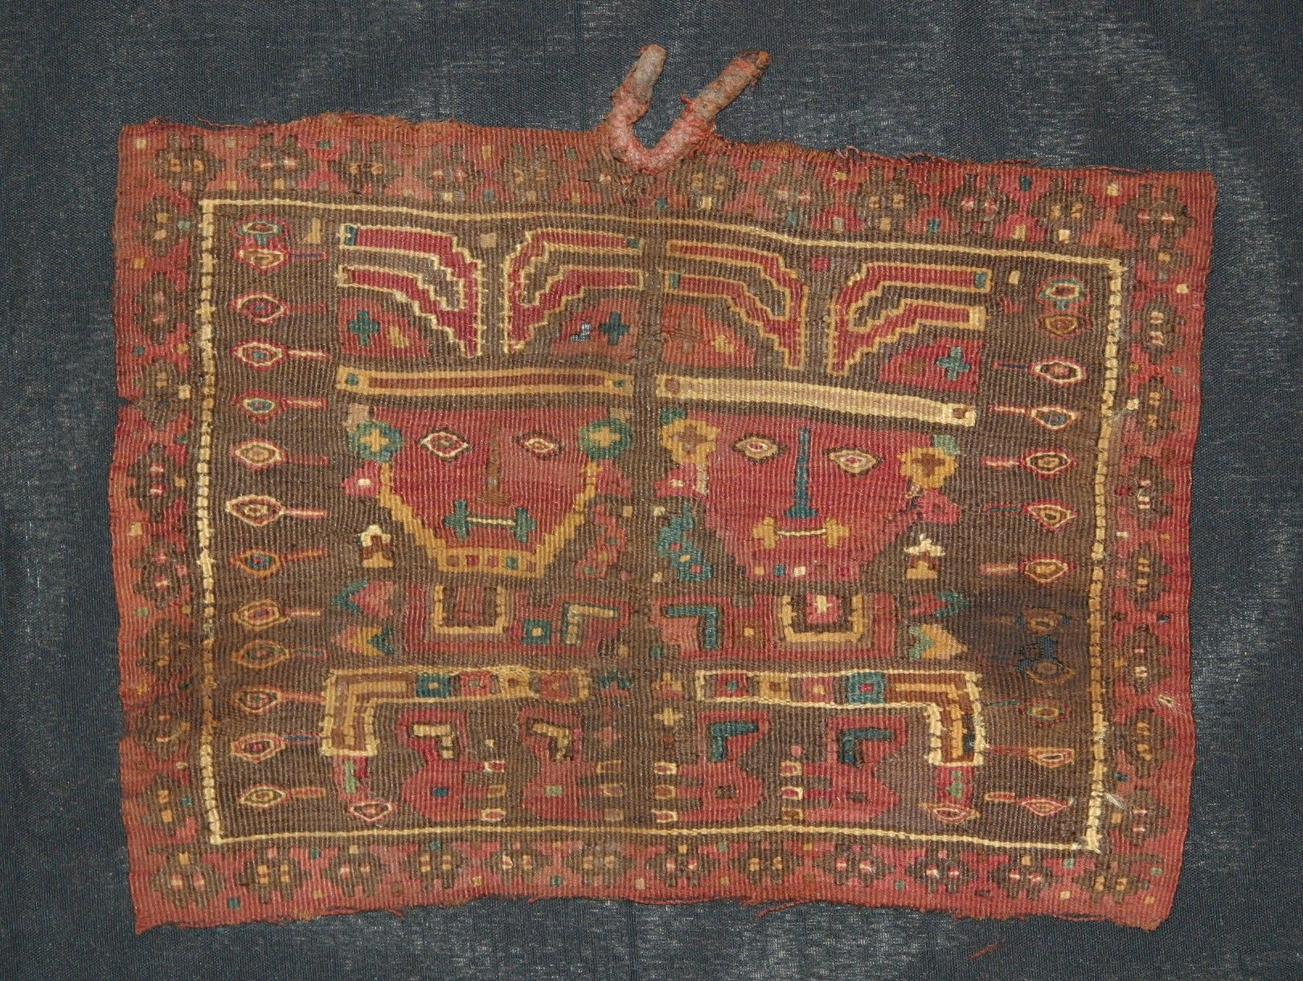
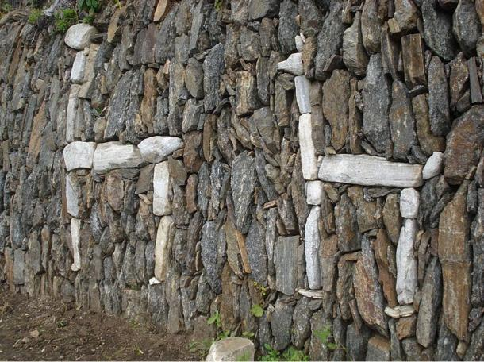
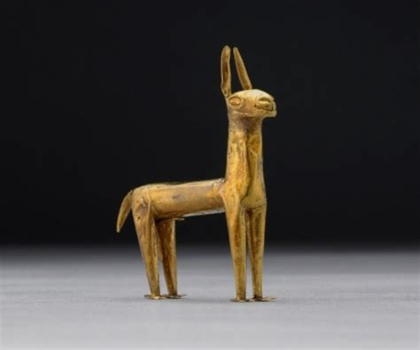
Artefacts
Top: Alpaca wool tapestry, Moche (600-900 AD)
Top-right: Two camelids in white stone, Choquequirao (pre-Columbian)
Right: Gold llama figurine, Peru (1400-1550 AD)

Slide 4
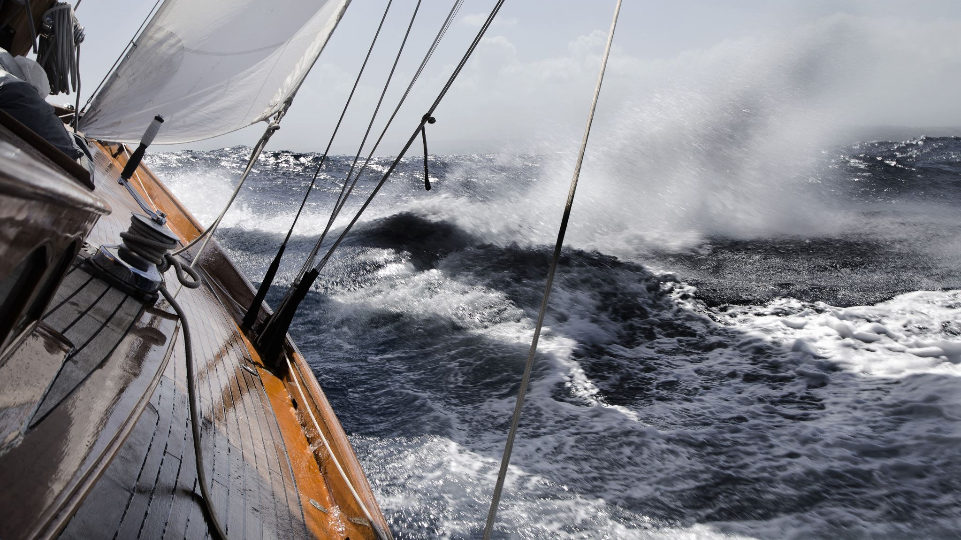

Spanish conquest

Slide 5
Previous research

Slide 6
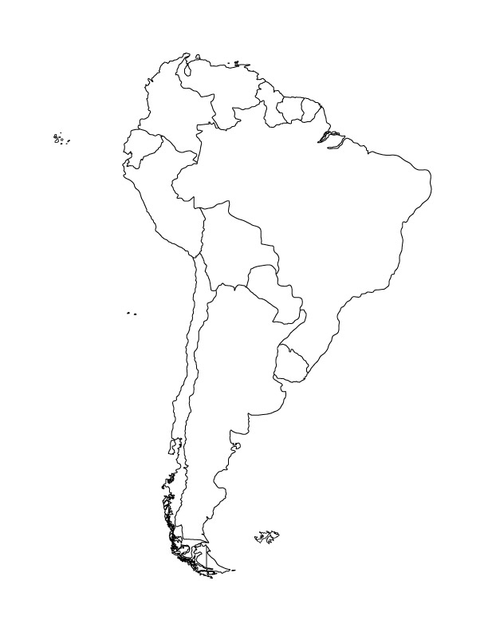
Archaeozoological Analysis
A measure of loss prehispanic llama and alpaca breeds (Wheeler et. al, 1992)
El Yaral (Moquegua, Peru)
Hunting and the origins of herding in Peru (Moore 1989)
Central Andes of Peru
5,000 – 3,800 B.P
Llama
Alpaca
Uniform, single coat fleece
Extra fine uniform, single coat fleece
Larger remains than guanaco
Double coat with coarser hairs
Fine uniform, single coat fleece
The domestication of South American camelids (Goñalons et. al, 2006)
N.W Argentina and Northern Chile
4,000 B.P
Today: Reduction in uniformity, increase in coarseness

Slide 7
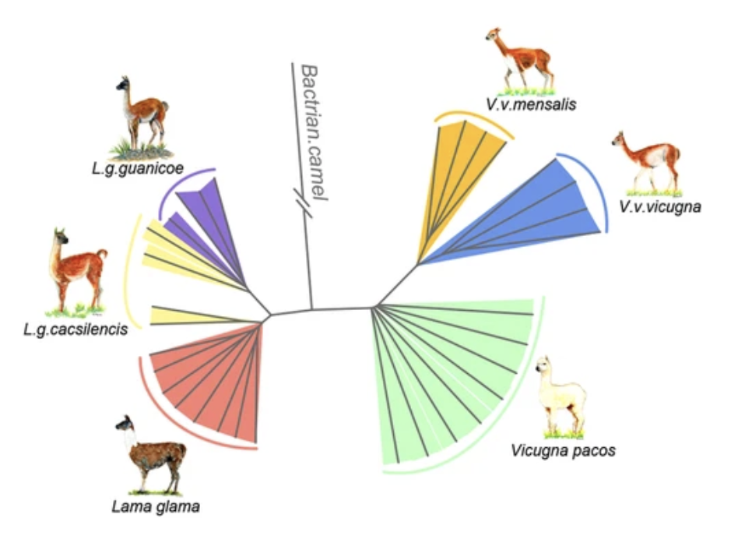
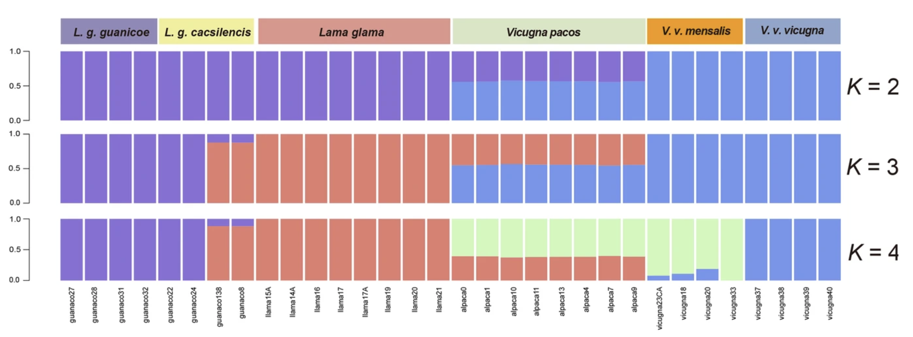
Genomic analysis of the domestication and post-Spanish conquest evolution of the llama and alpaca (Fan et. Al, 2020)
Introgression between llamas (5%) and alpacas (36%)
Llama domesticated from cacsilensis

Slide 8
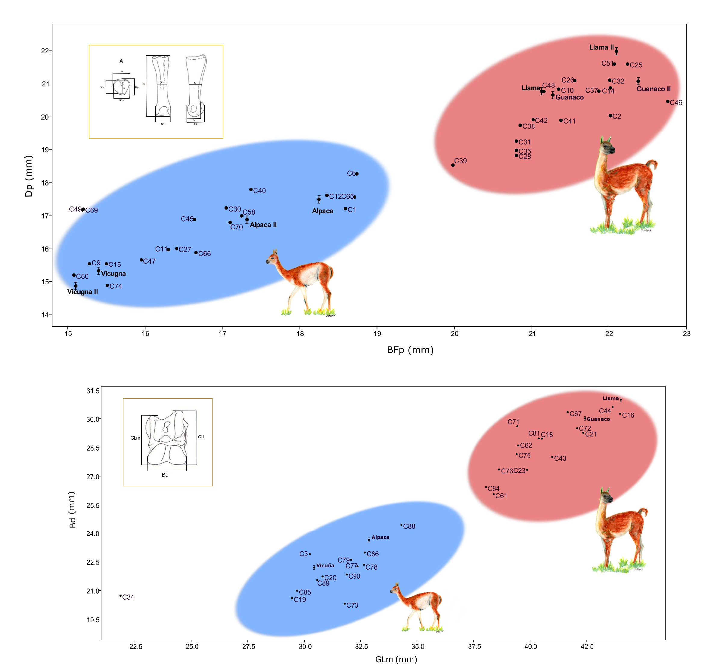
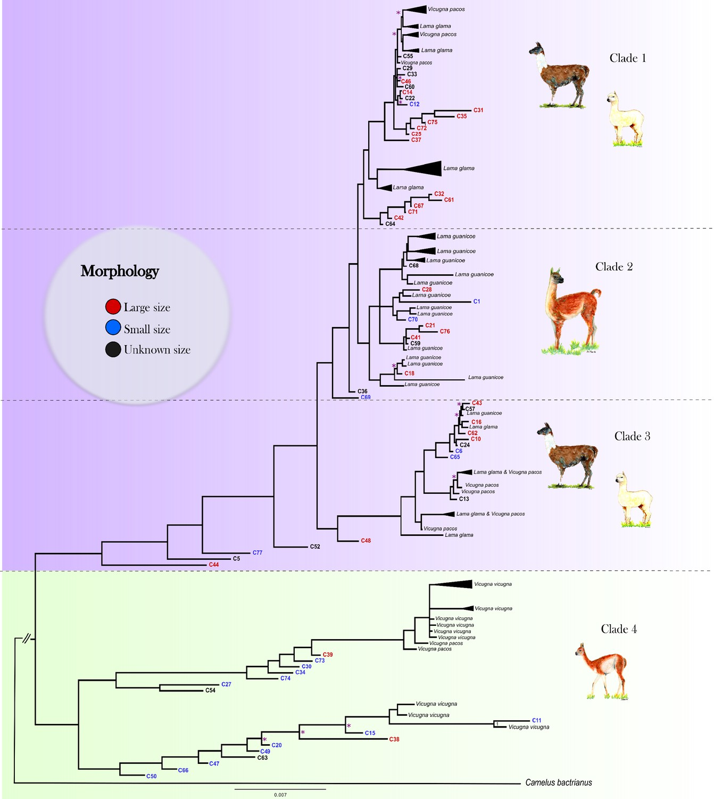
Ancient DNA reveals the lost domestication history of South American camelids in Northern Chile and across the Andes (Diaz-Maroto et. Al, 2021)
Phylogeny from mtDNA
Osteometrical Sizes
Llamas and alpacas domesticated from guanacos
Anterior phalanx
Difficult to distinguish between subspecies within lama and vicugna respectively
Astralagus

Slide 9
objectives

Slide 10
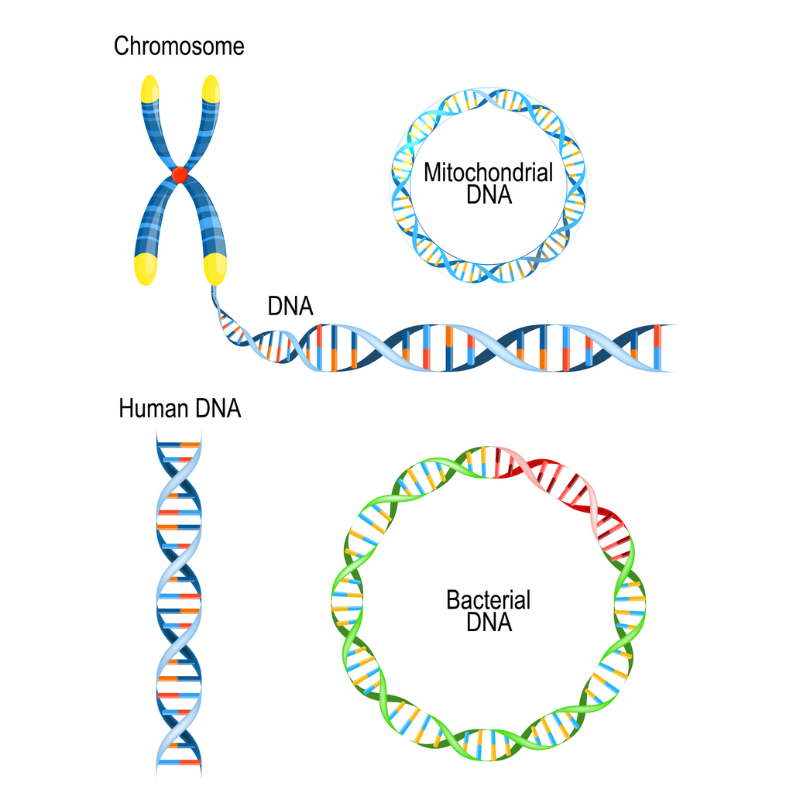
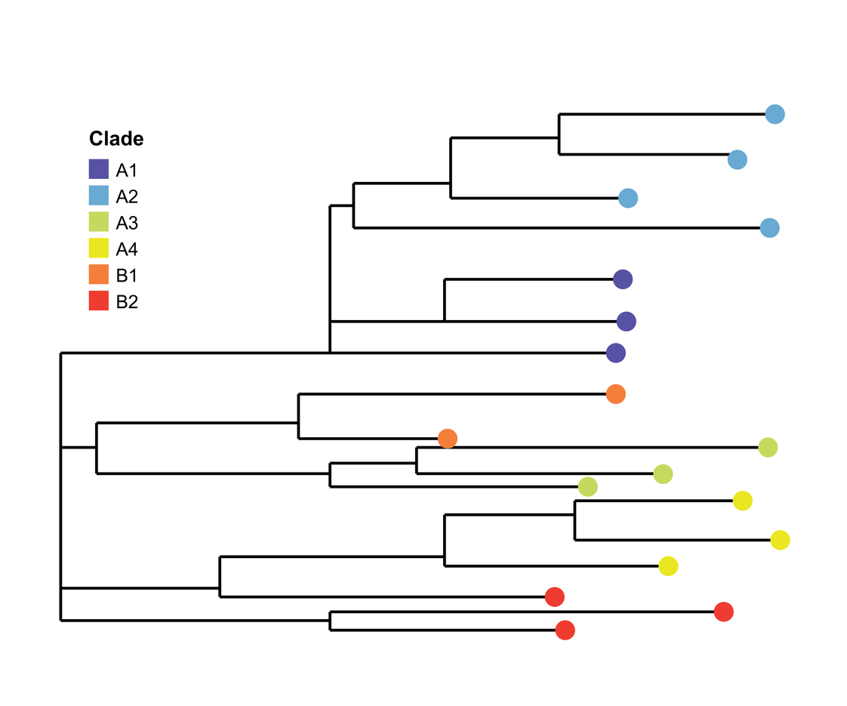
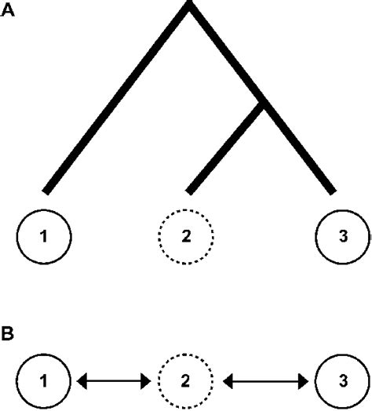
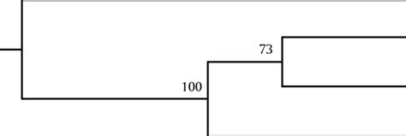
Key extension: nuclear DNA of ancient samples
Improved analysis of
Phylogeny
Major overlap in samples from Fan et. al, 2020 and Diaz-Maroto et. al, 2021
Gene flow
Informative comparison
Genetic distance

Slide 11
Materials

Slide 12
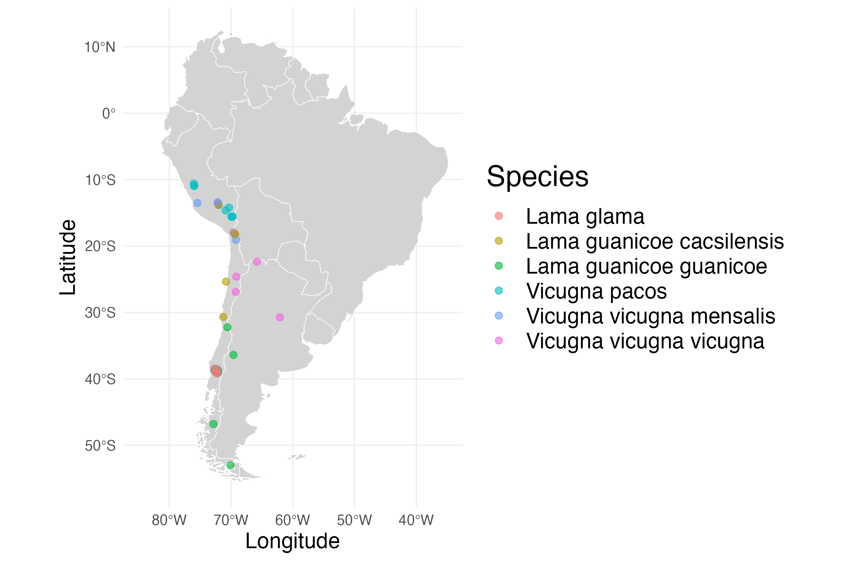
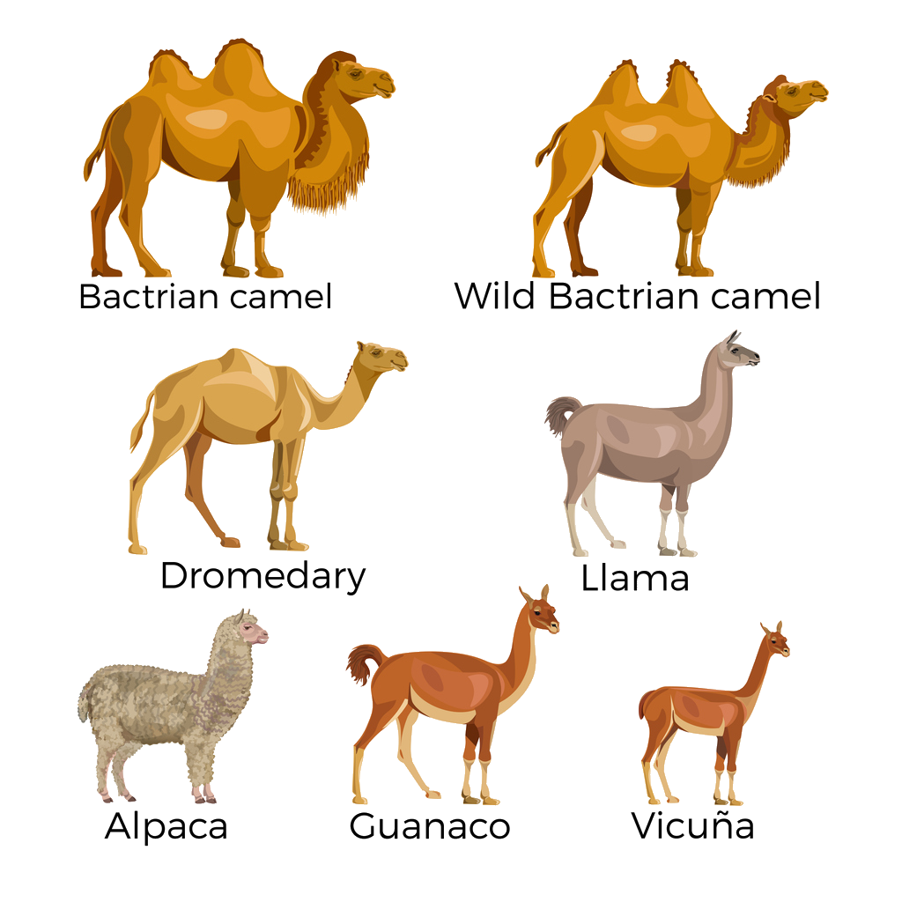
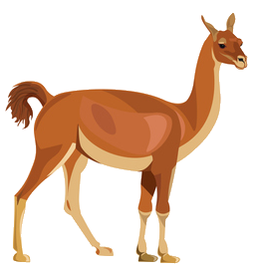
Modern samples
Lama Glama (9)
domesticate
Lama
Lama Guanicoe
(4 Guanaco, 4 Cacsilensis)
wild
Vicugna Pacos (16)
domesticate
Vicugna
Vicugna Vicugna
(4 mensalis, 4 vicuña)
wild

Slide 13
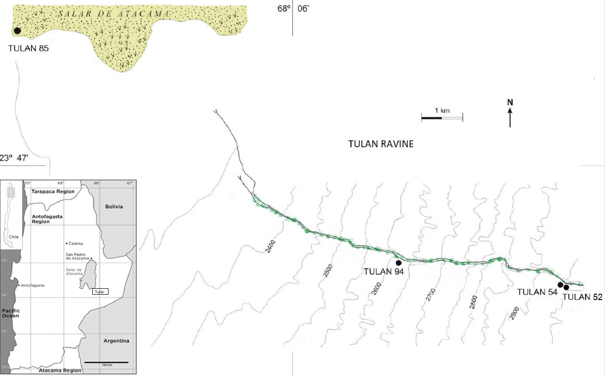
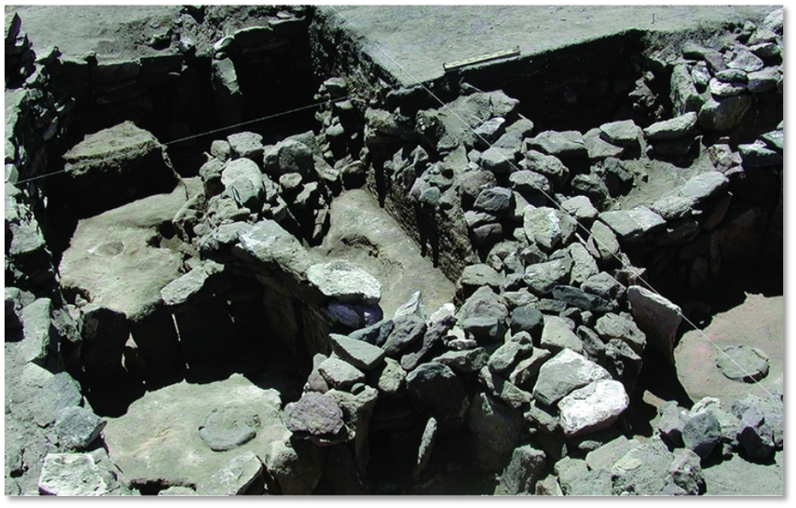
Ancient samples
Tulan-85: Domestic area with few residential structures (15 samples)
TU-52 (1)
TU-94 (1)
+
Tulan-54
Tulan-54: Cultural and economic site
Shows signs of development of ceremonial structures (58 samples)
(Núñez et al. 2017)
(Diaz-Maroto et. al, 2021)

Slide 14
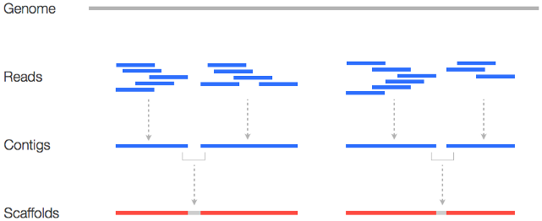
Data sequencing & preparation
Vicugna Pacos
Reads
Modern Sample 1
Modern Sample 2
Modern Sample 3
⋮
Ancient Sample 1
Ancient Sample 2
Ancient Sample 3
BAM (Binary Alignment Map) files

Slide 15
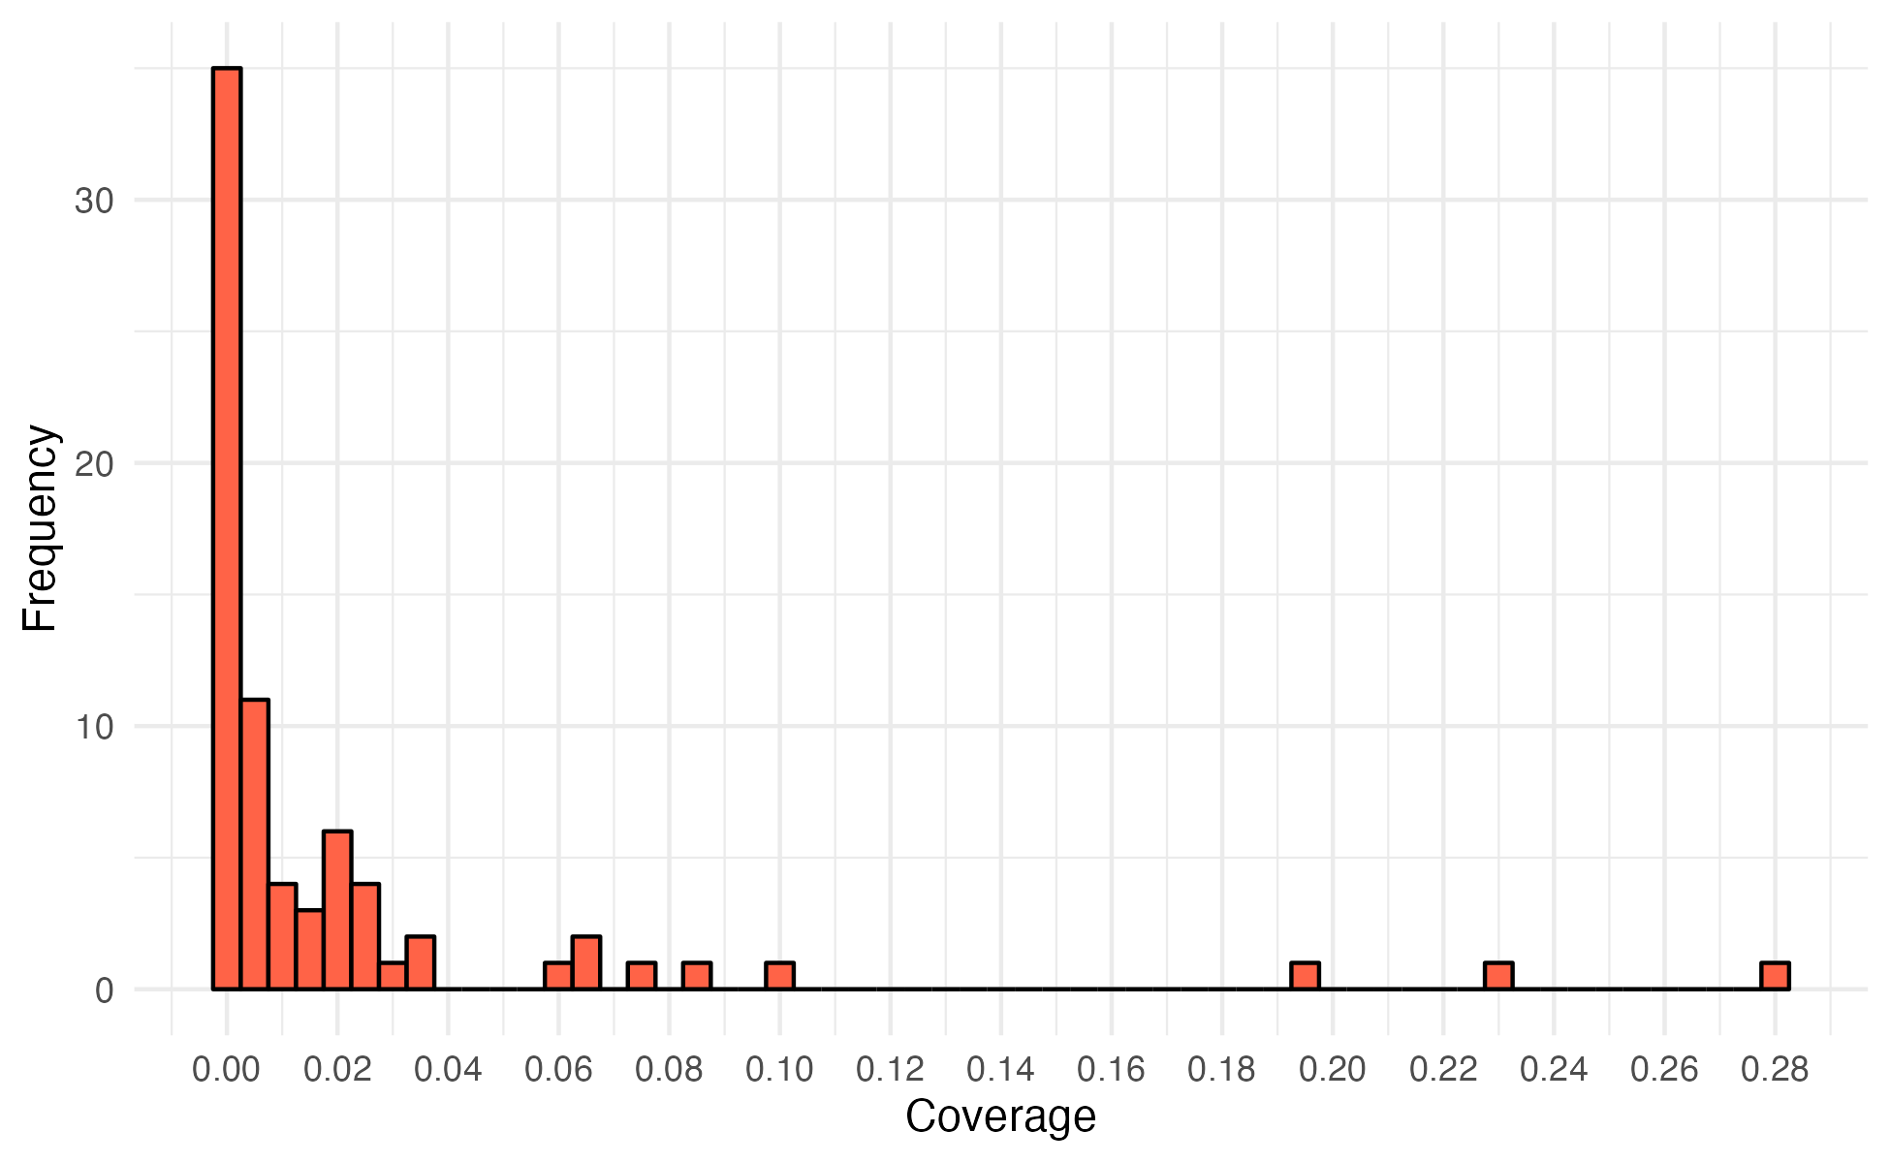
Coverage of ancient samples
(One) problem with ancient DNA: Many samples with low coverage
Compromise: Only consider samples of coverage >0.01X
26 from 75 samples remaining

Slide 16
Principal component analysis

Slide 17
Theory
Problem: If we want to plot each sample where the coordinates represent the genotype for each loci, then we would have (#loci) dimensions!
Solution: Only consider the axes of highest variation.
Step 1: Compute genotype matrix
Step 2: Compute covariance matrix
 | Sample 1 | Sample 2 | Sample 3 | …
SNP 1 | 2 | 0 | 1 | …
SNP 2 | 2 | 1 | 1 | …
SNP 3 | 2 | 2 | 2 | …
SNP 4 | 2 | 2 | 1 | …
⋮ | ⋮ | ⋮ | ⋮
 | Sample 1 | Sample 2 | Sample 3 | …
Sample 1 | 0 | 1.1 | 1.2 | …
Sample 2 | 1.1 | 1.1 | 1.3 | …
Sample 3 | 1.2 | 1.3 | 2 | …
Sample 4 | -0.2 | -0.4 | 0.2 | …
⋮ | ⋮ | ⋮ | ⋮
Step 3: Compute eigenvectors (Principal Components) and eigenvalues (amount of variance)

Slide 18
Quality control
We need to apply some restrictions, to avoid spurious associations whilst maintaining power
SNP p-value threshold
Removing transition mutations
Minor allele frequency
Considerations
Unique mapping
Biallelic sites
Base & mapping quality
Sites found in all modern samples and at least one ancient sample

Slide 19
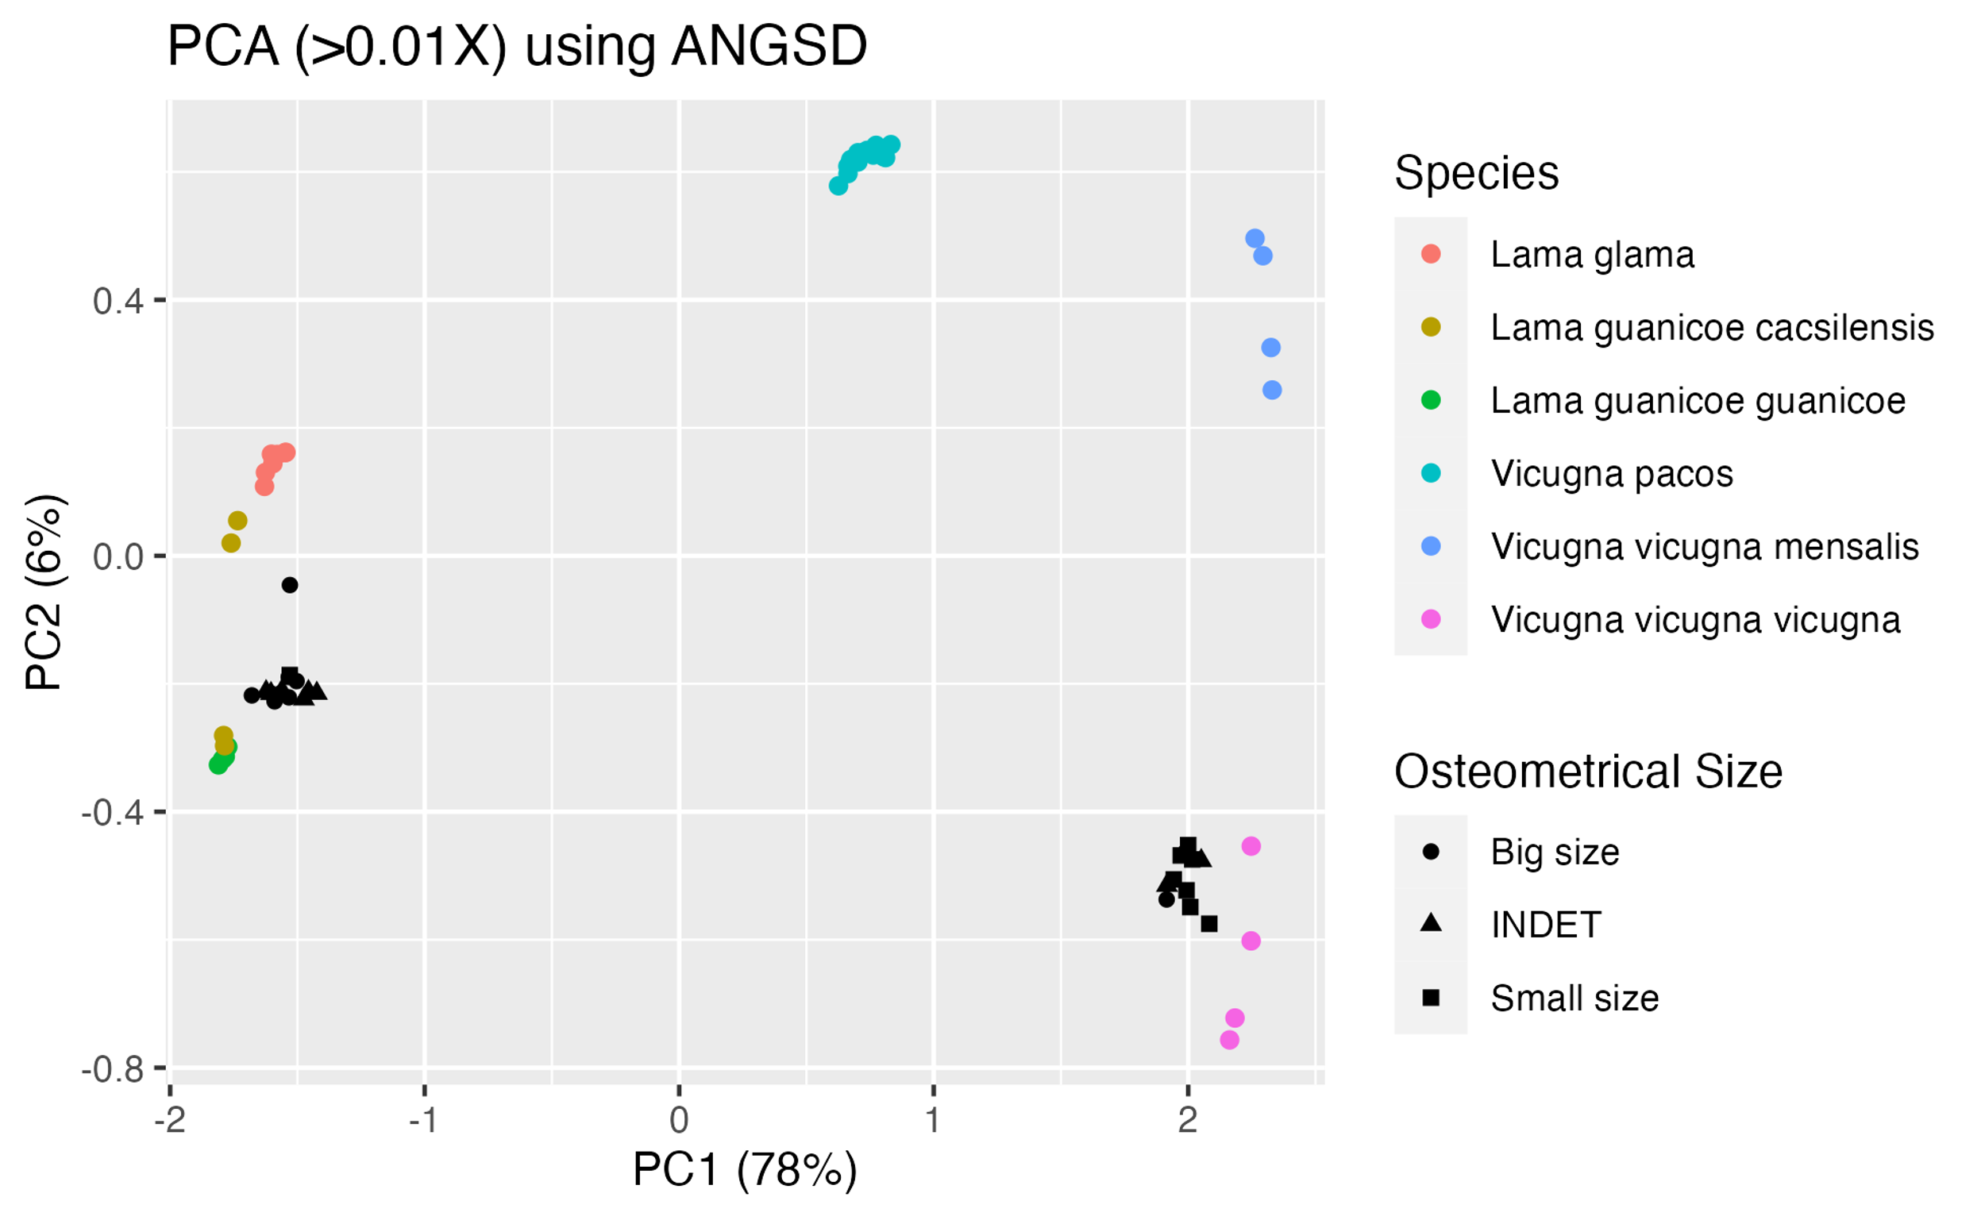
Alpacas
Potential signs of introgression
C72
Size: Big
Site: TU-54
Coverage: 0.075X
Cacsilensis
Mislabelling?
A
C21
Size: Big
Site: TU-54
Coverage: 0.281X
Ancient clusters near wild species
B
C20
Size: Small
Site: TU-54
Coverage: 0.230X

Slide 20
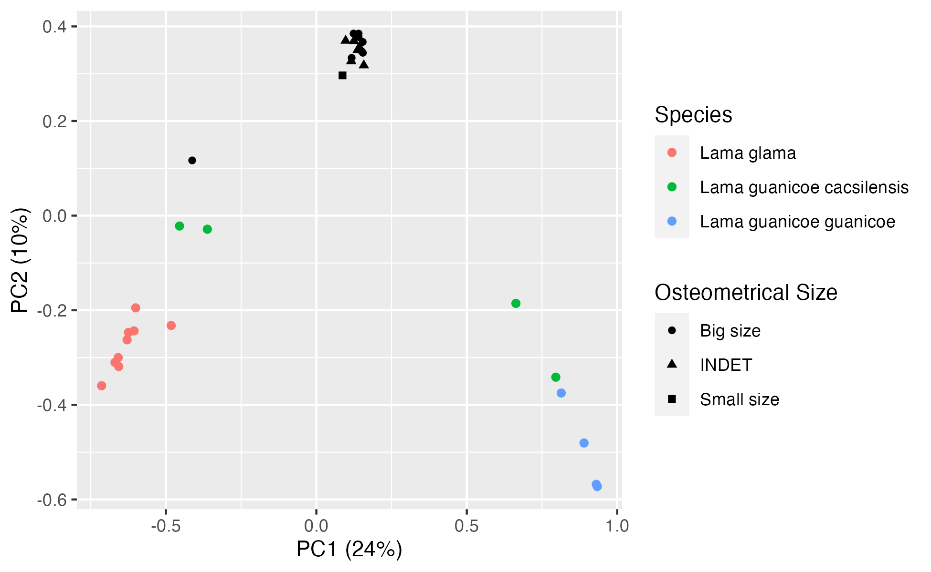
Pca of Lama genus only
A

Slide 21
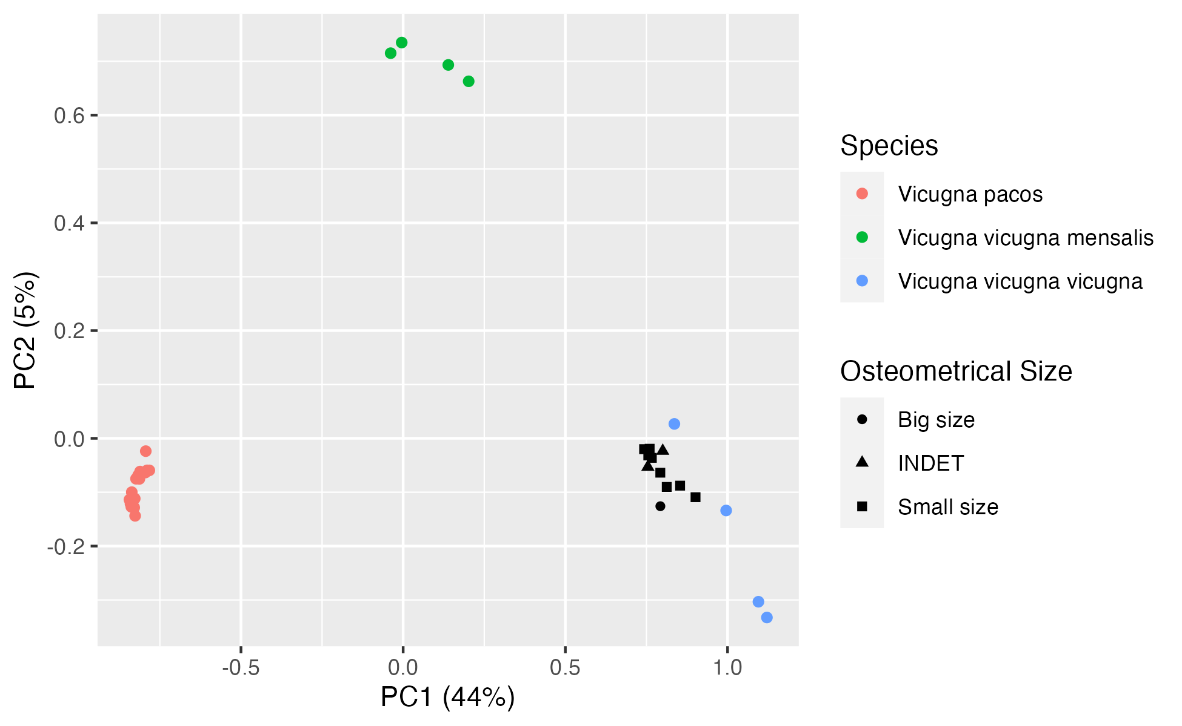
Pca of vicugna genus only
B

Slide 22
Ancient DNA damage

Slide 23
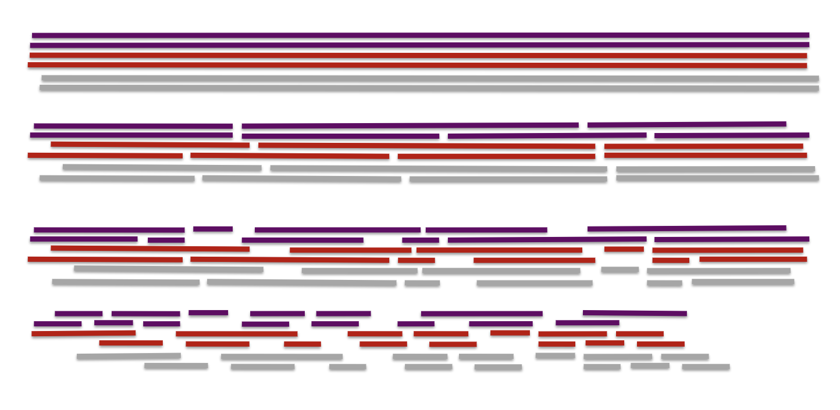
Damage #1: fragmentation
Increased rate of hydrolysis
Our ancient samples are from a warm climate
Increased microbial diversity, producing more enzymes
Time

Slide 24
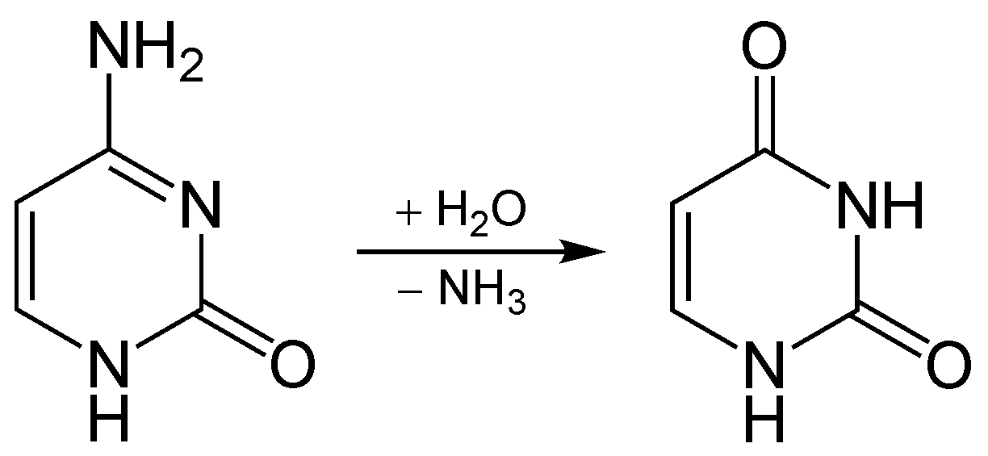
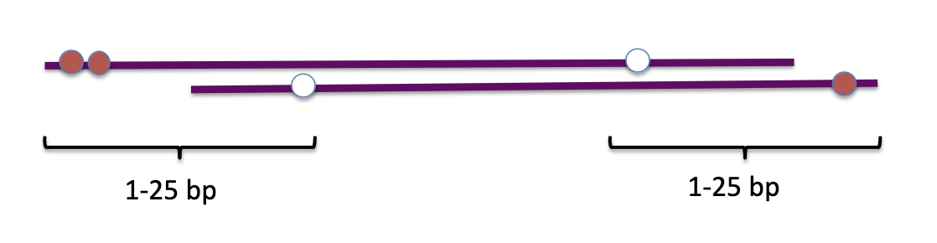
Damage #2: Deamination
Hydrolysis of the Cytosine amino group (- NH₃)
Type 1: cytosine deamination (C → T)
C → U
Recognised as error in DNA replication and repaired
U → T
Type 2: 5-methylcytosine deamination (G → A)
C → T
G → A on 3’-end
How we compare rates of deamination

Slide 25
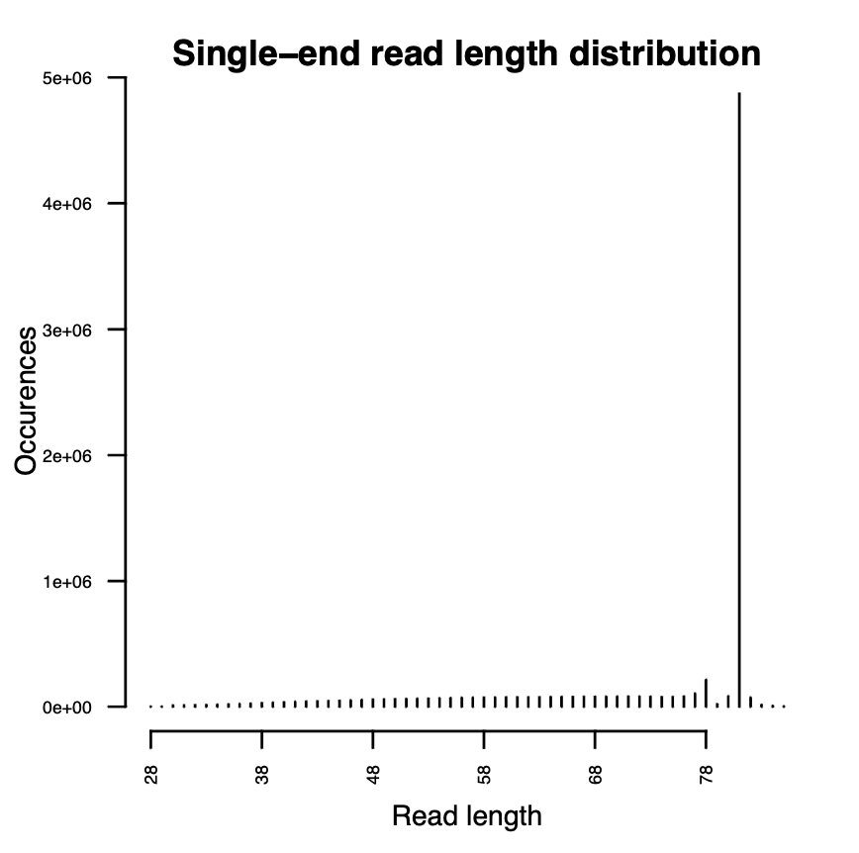
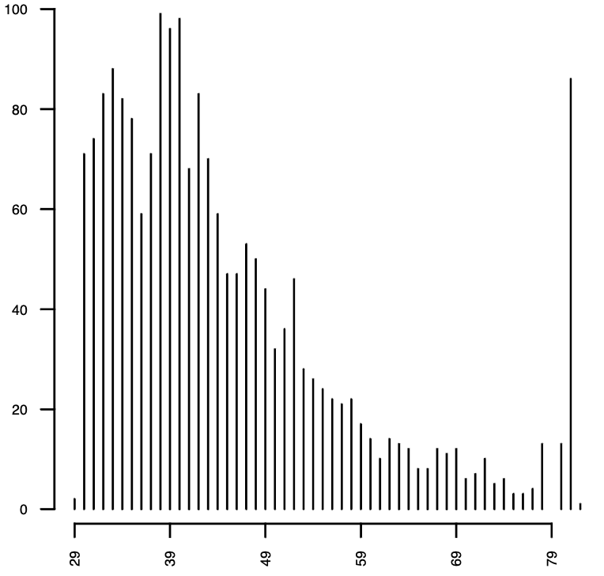
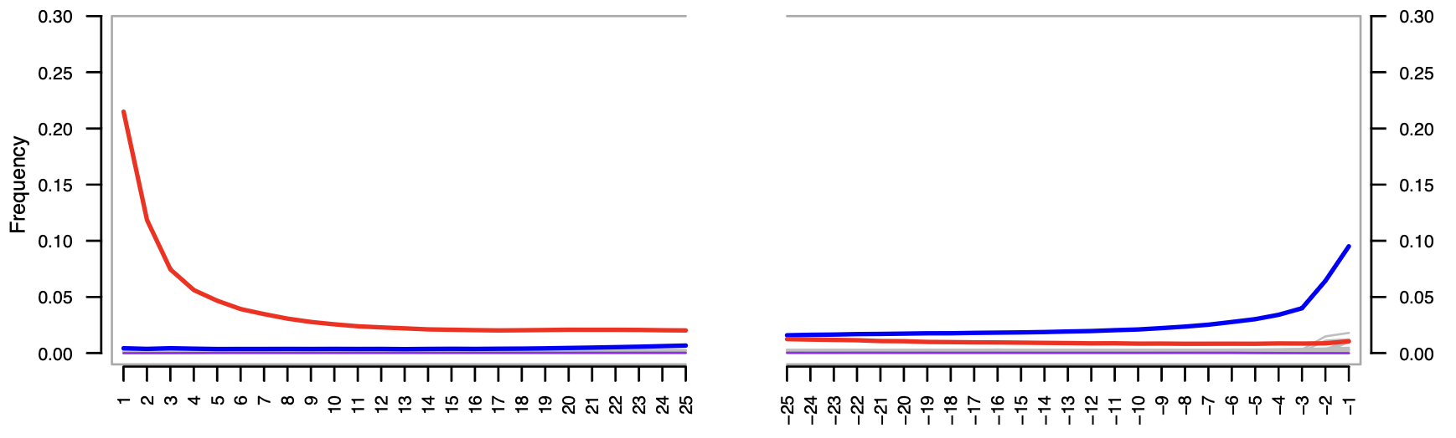
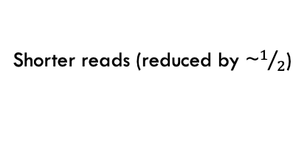
Damage profile for C21
Most reads capped at 81bp due to sequencing limits (75bp + adaptors)
C1
Frequency of deamination
Good results for an ancient sample – lower coverage ancient samples would have more shorter reads
: C → T
: G → A
Apply damage profile to modern samples
Coverage of 0.01X
Shorter reads (reduced by ~$1/2$)
Deamination

Slide 26
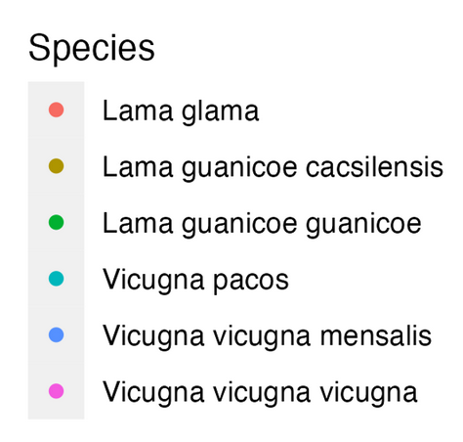
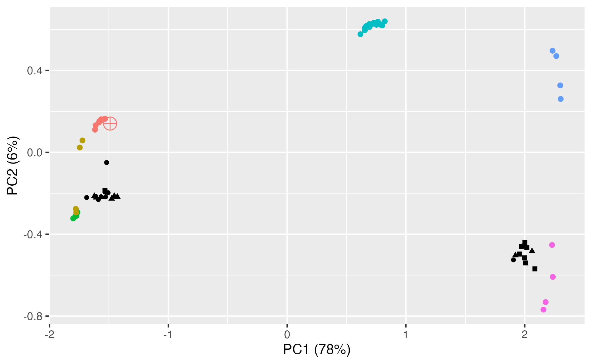

Damage to modern samples
Llama
Cacsilensis
No strong deviation
Towards C72
A
A
B
B

Slide 27

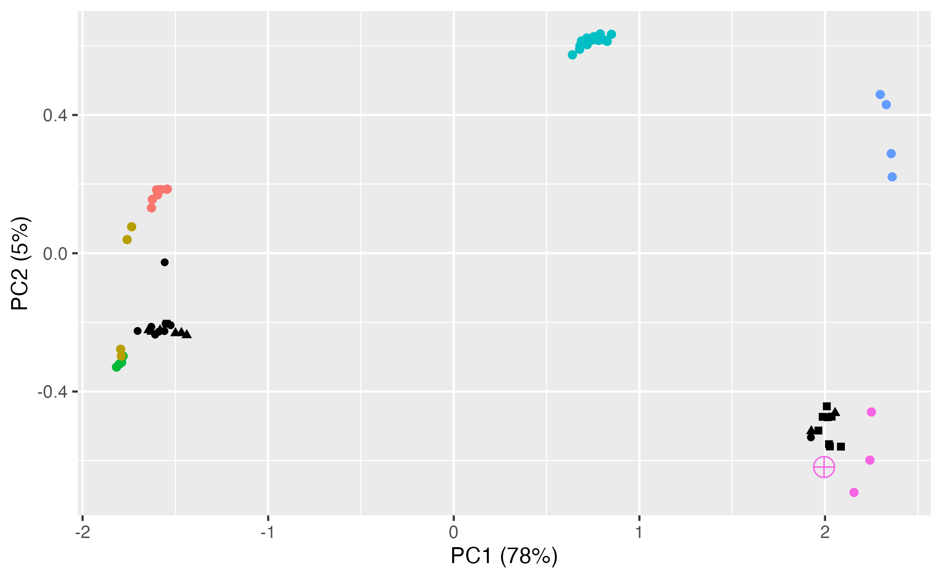
Damage to modern samples
Guanaco
Vicuña
A
A
Towards Cluster A
B
Towards Cluster B
B

Slide 28
Phylogeny

Slide 29
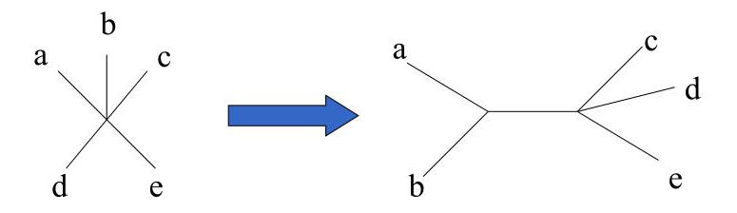
theory
Aim: To determine the evolutionary relationship between modern and ancient samples
IBS (Identity By State) Matrix
Neighbour Joining
Total similarity
1
 | Sample 1 | Sample 2 | Sample 3 | …
Sample 1 | 1 | 0.8 | 0.2 | …
Sample 2 | 0.8 | 1 | 0.3 | …
Sample 3 | 0.2 | 0.1 | 1 | …
Sample 4 | 0.3 | 0 | 0.2 | …
⋮ | ⋮ | ⋮ | ⋮
No similarity
0
Topology
Branch lengths (proportional to some measure of divergence)
Extant taxa are not aligned, BUT all are still contemporary and equally evolved
Phylogram

Slide 30
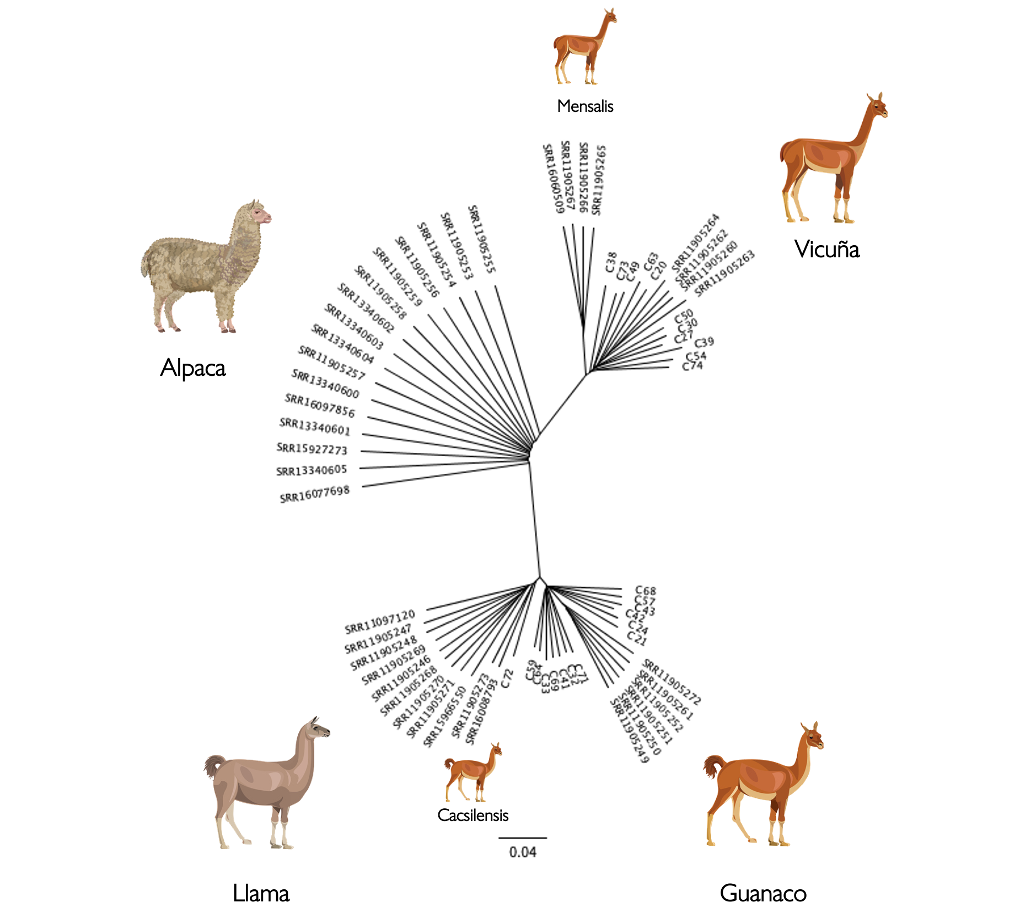
Phylogeny using nuclear DNA
B
Ancient vicuña population?
Split of ancient guanacos to form two species
Llama domesticated from cacsilensis?
Ancient guanaco population?
A
Ancient cacsilensis?

Slide 31
Phylogeny using mitochondrial DNA
Domesticated from extant guanaco
Two domesticate clades
*
Domesticated from extinct guanaco
Not all ancient samples cluster as in nDNA
Cluster A
Cluster B
*
Only 9 of 13 ancient samples from nDNA guanaco clade are in Clade 2
No difference
*

Slide 32
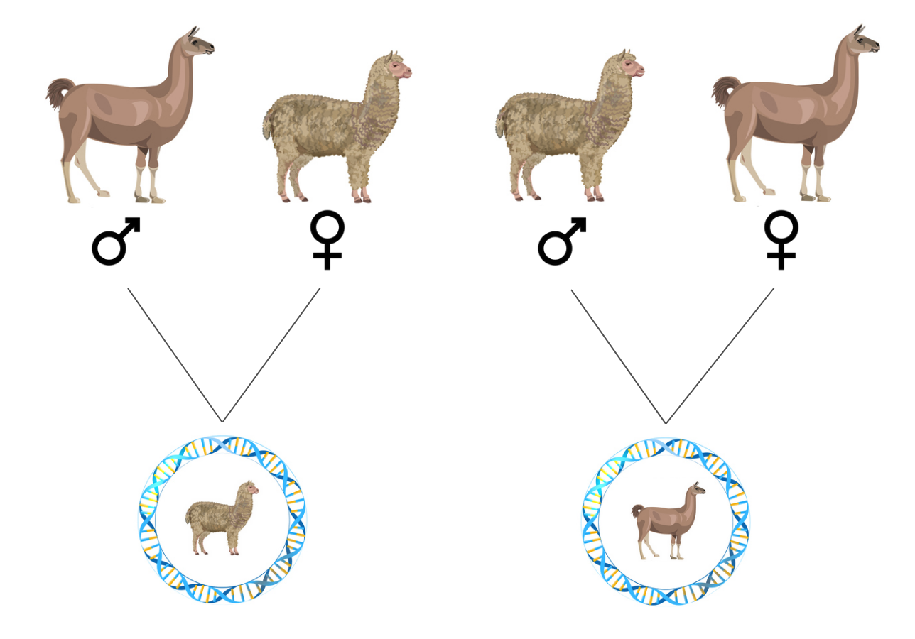
Nuclear –vs – mitochondrial DNA
Q: Why do we see differences in topology?
Key reason: mtDNA is maternally inherited
Another theory: mtDNA has a higher mutation rate, which can overestimate genetic distance
Confounded by hybridization between llamas and alpacas

Slide 33
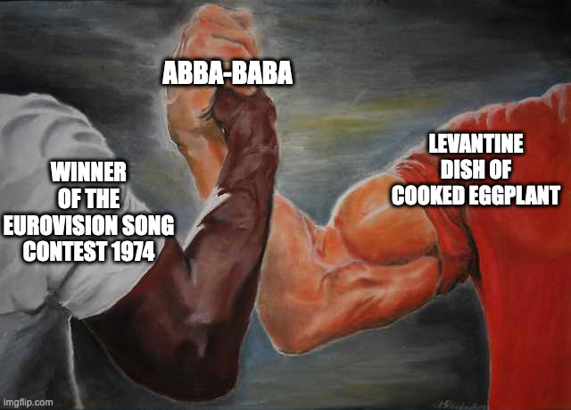
Abba-baba statistics

Slide 34
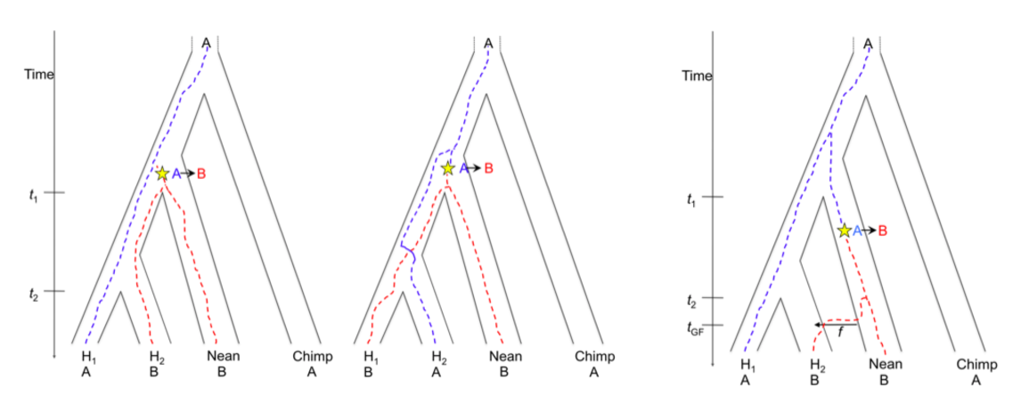
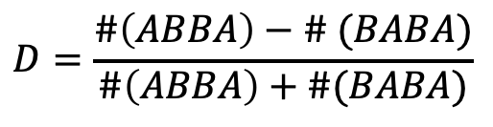
Theory
Aim: Test for a deviation from a strict bifurcating evolutionary history
$$D=\frac{\#\left(ABBA\right)−\# (BABA)}{\#\left(ABBA\right)+\#(BABA)}$$
Incomplete lineage sorting: Ancestral genes that coalesce deeper than speciation event
A’
B’
C’
O
A’
B’
C’
O
A’
B’
C'
O
A
B
B
A
B
A
B
A
A
B
B
A
Our interpretation: Compare shared derived alleles to determine relatedness

Slide 35

Method
2. Choose modern species
4. Determine significance using jack-knifing
Sample-set
Loci 2
Loci 3
Loci 4
Loci 5
⋮
1. Position ancient sample as taxa C
D-statistic
3. Compute D-statistic for all possible permutations of samples from the selected species
Standard error
Sample-set
Loci 1
Loci 3
Loci 4
Loci 5
⋮
D-statistic
Taxa A | Taxa B | D-statistic
Llama 1 | Guanaco 1 | 0.3
Llama 1 | Guanaco 2 | 0.2
Llama 1 | Guanaco 3 | 0.4
Llama 1 | Guanaco 1 | 0.4
⋮ | ⋮ | ⋮
A B C O
5. Plot comparisons by species-pairing with indication of significance

Slide 36
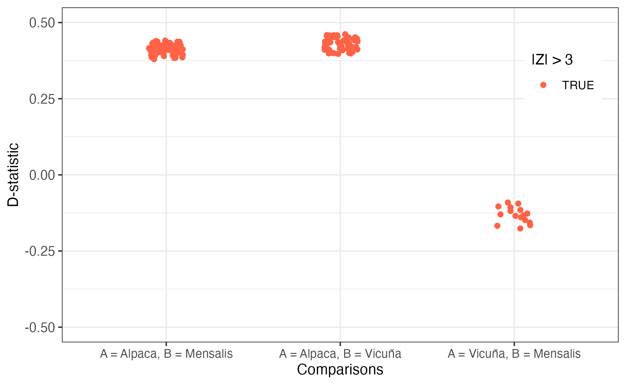
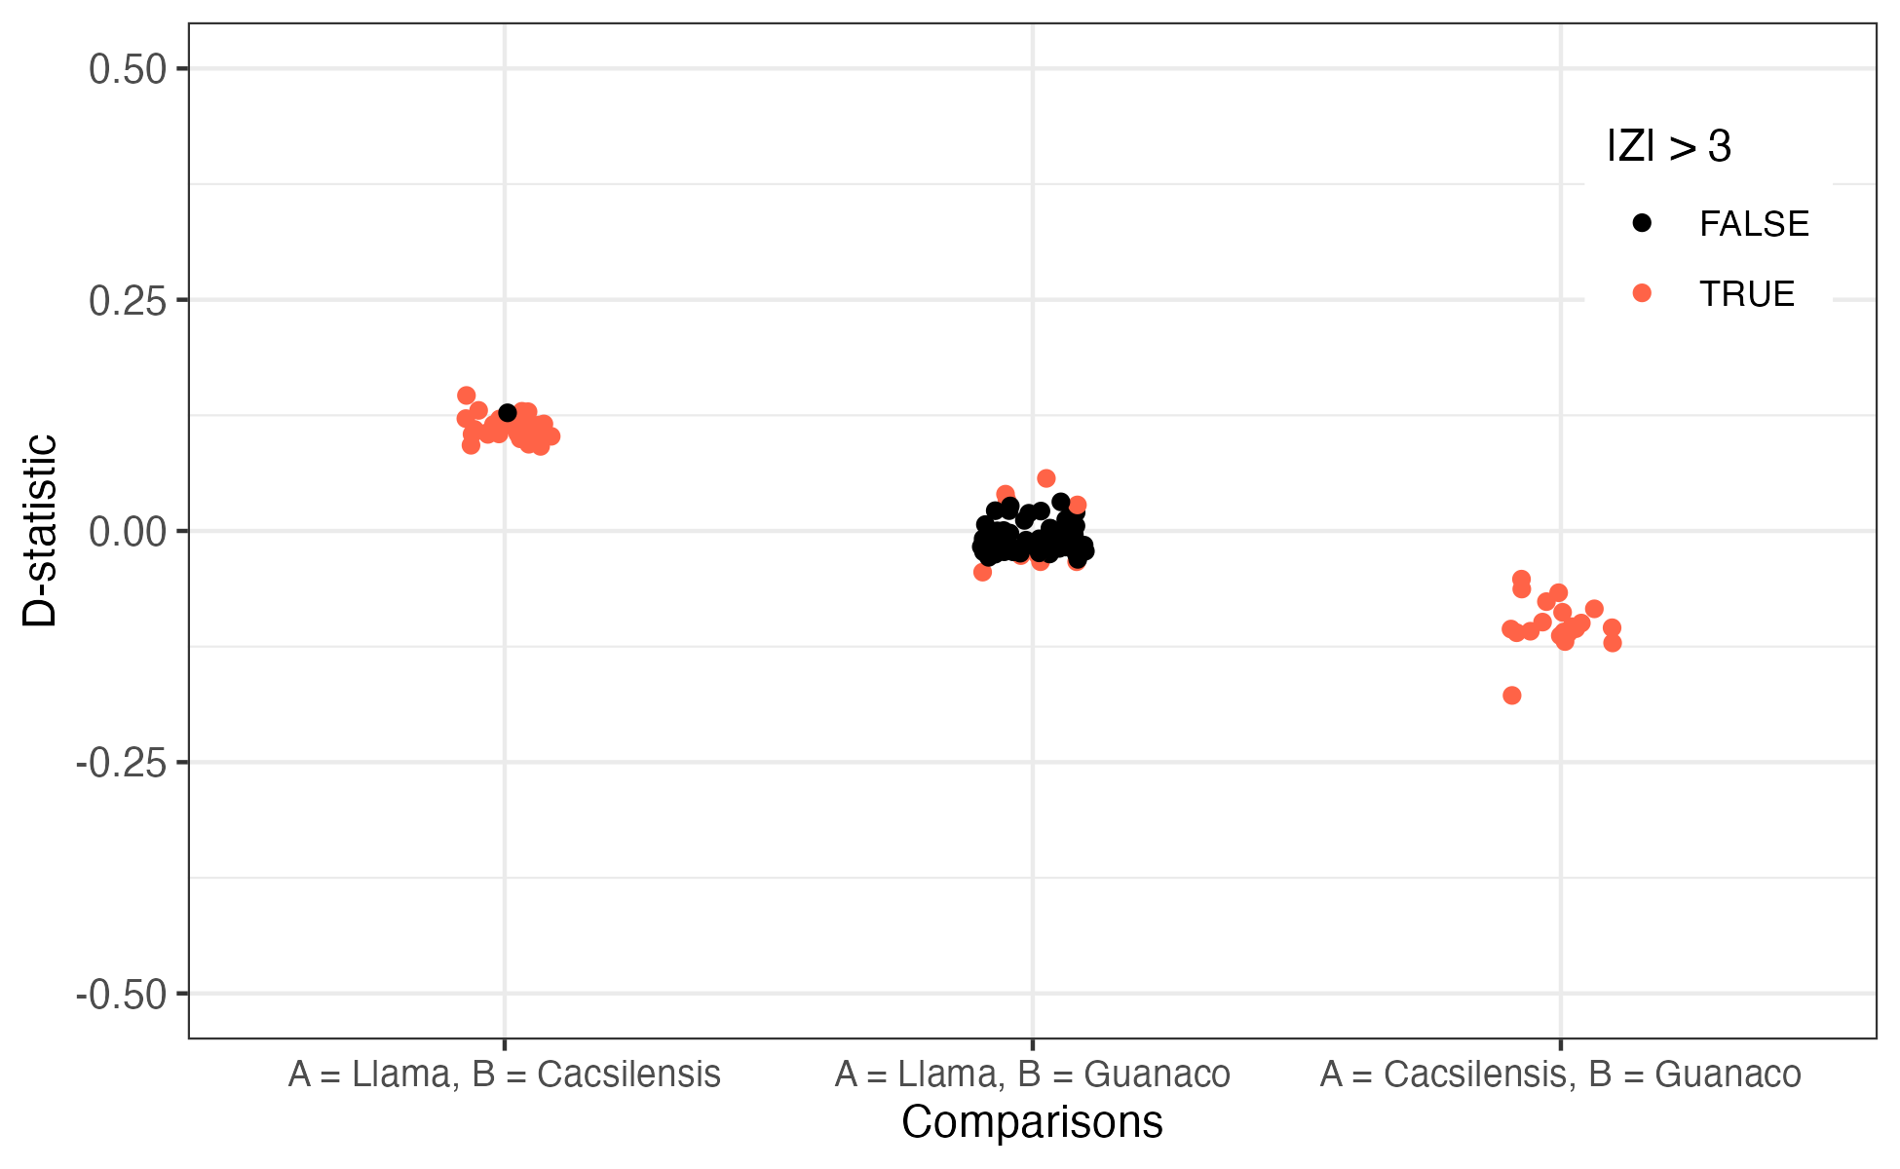
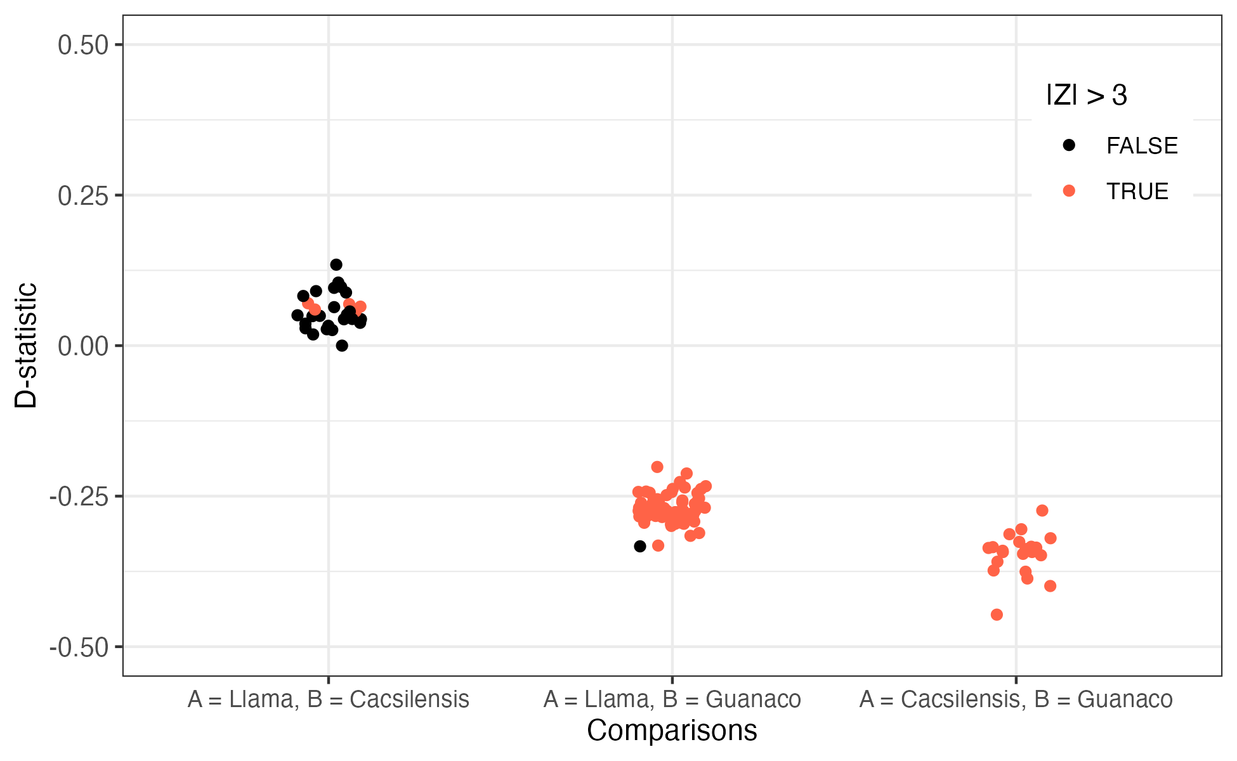
C20 (Cluster B)
C21 (Cluster A)
C72
Vicuña
Cacsilensis
Cacsilensis
Why is this not guanaco?
Possible reason: We are only considering ABBA and BABA sites
Additionally, genetic distance involves missing data in the computation

Slide 37
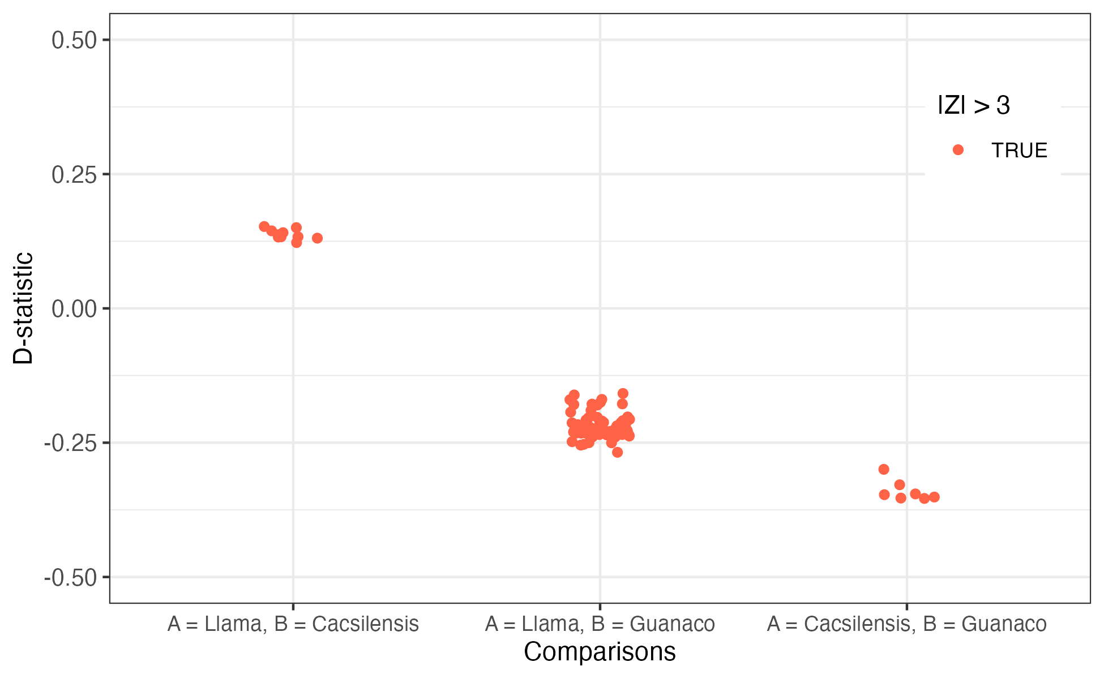
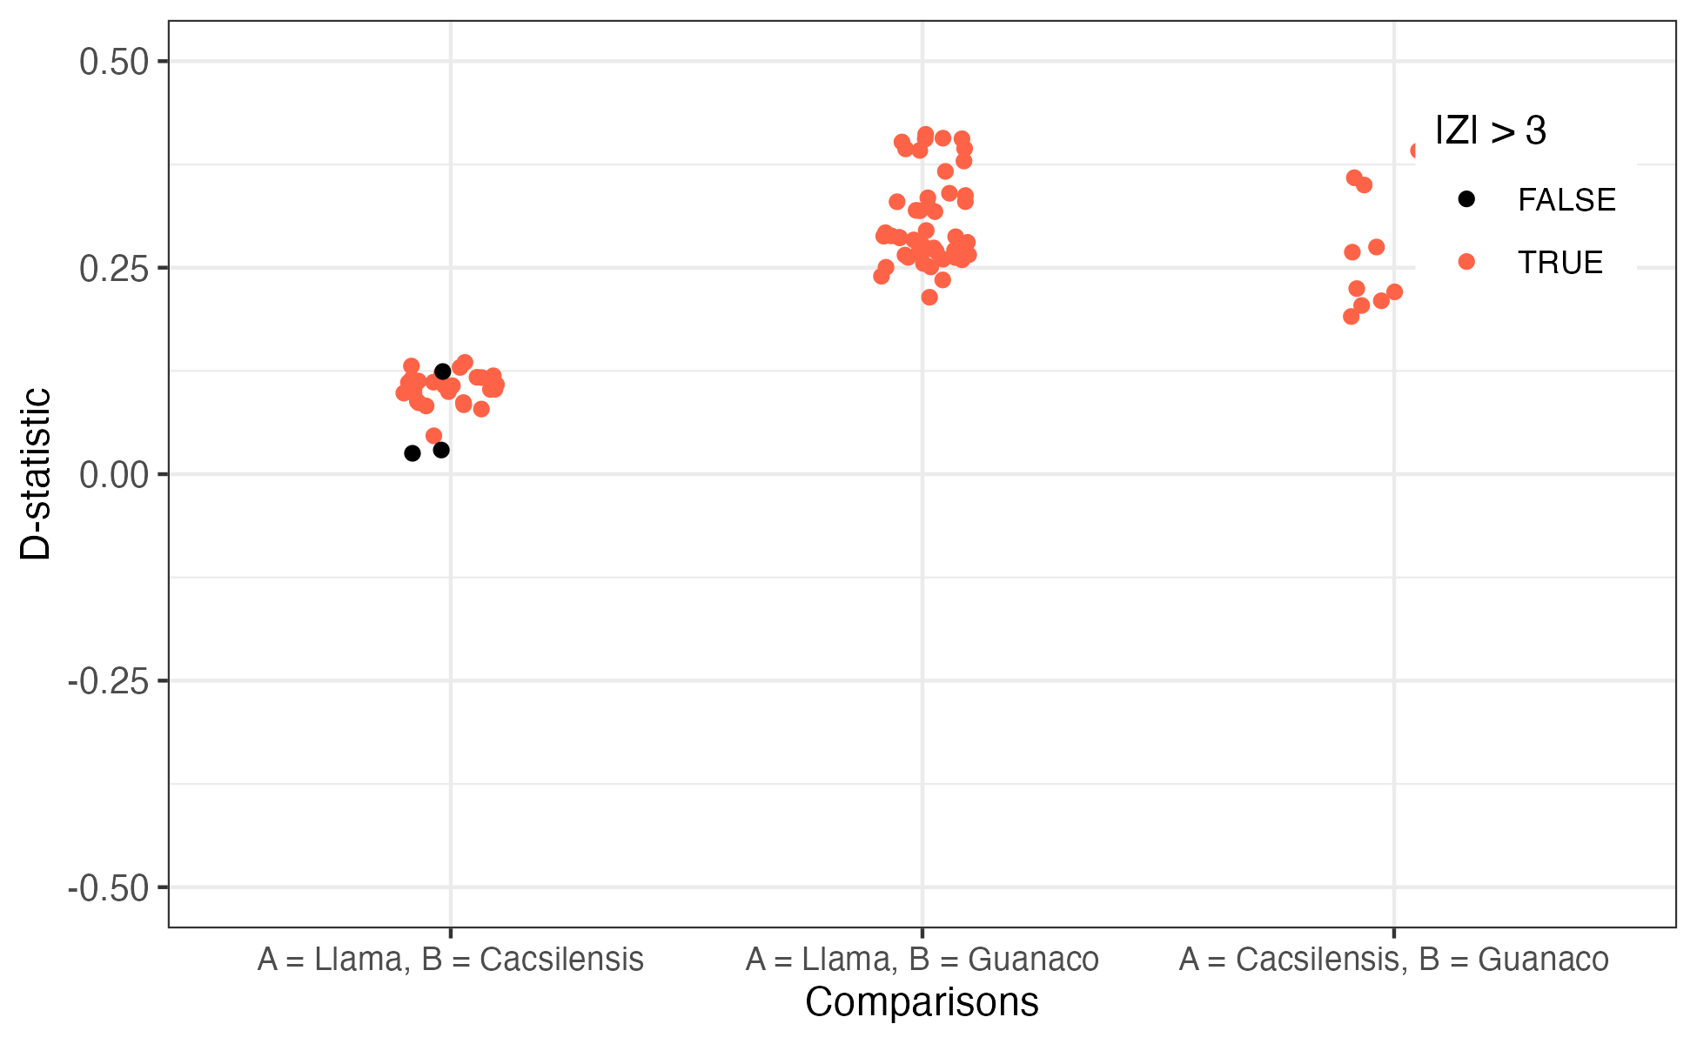
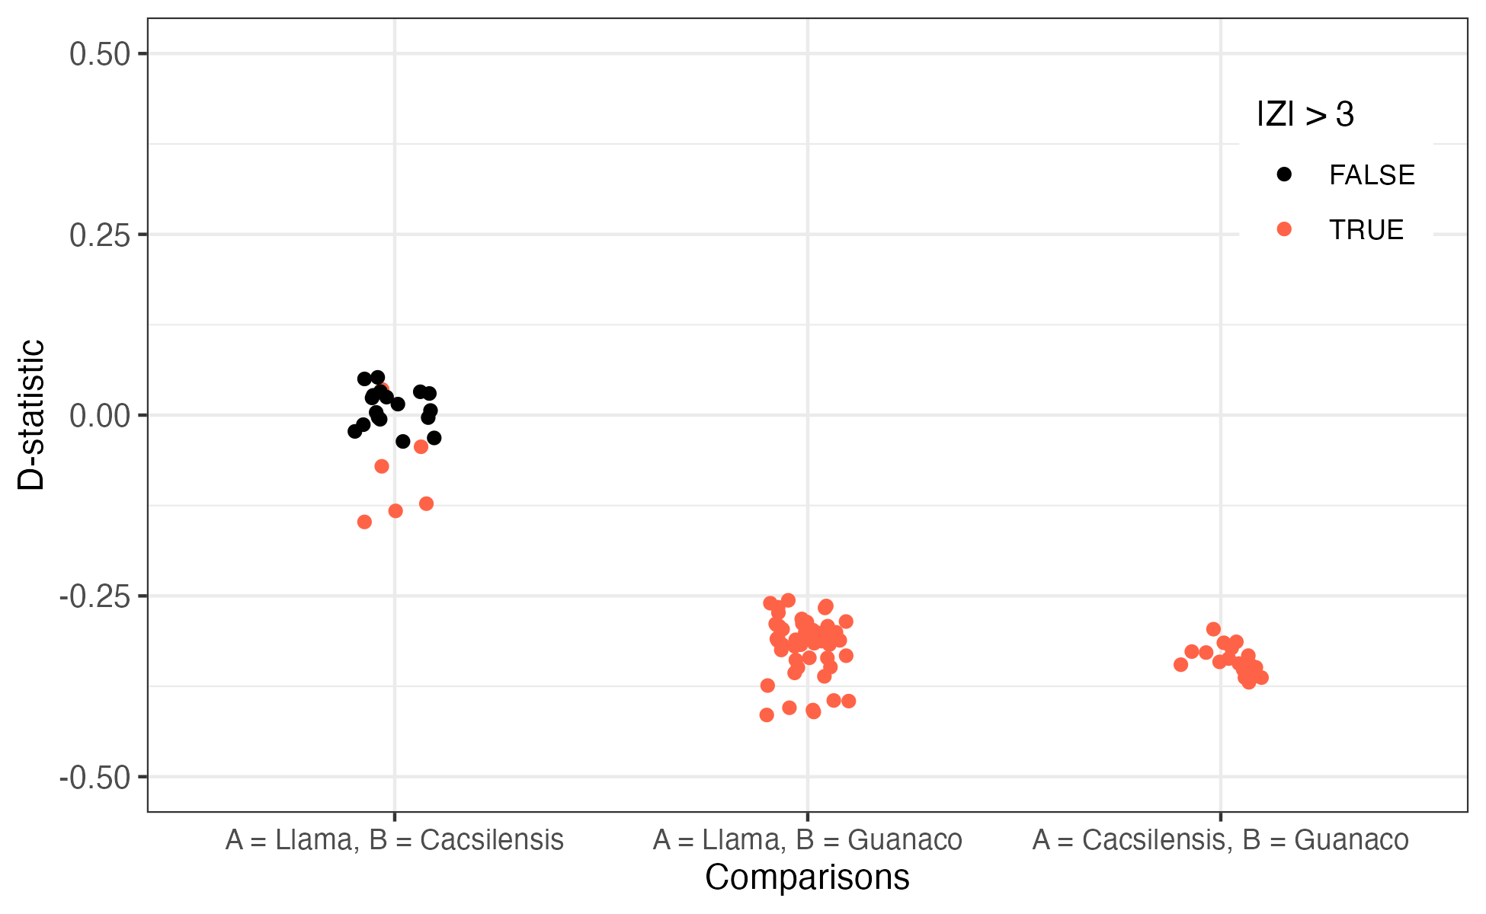
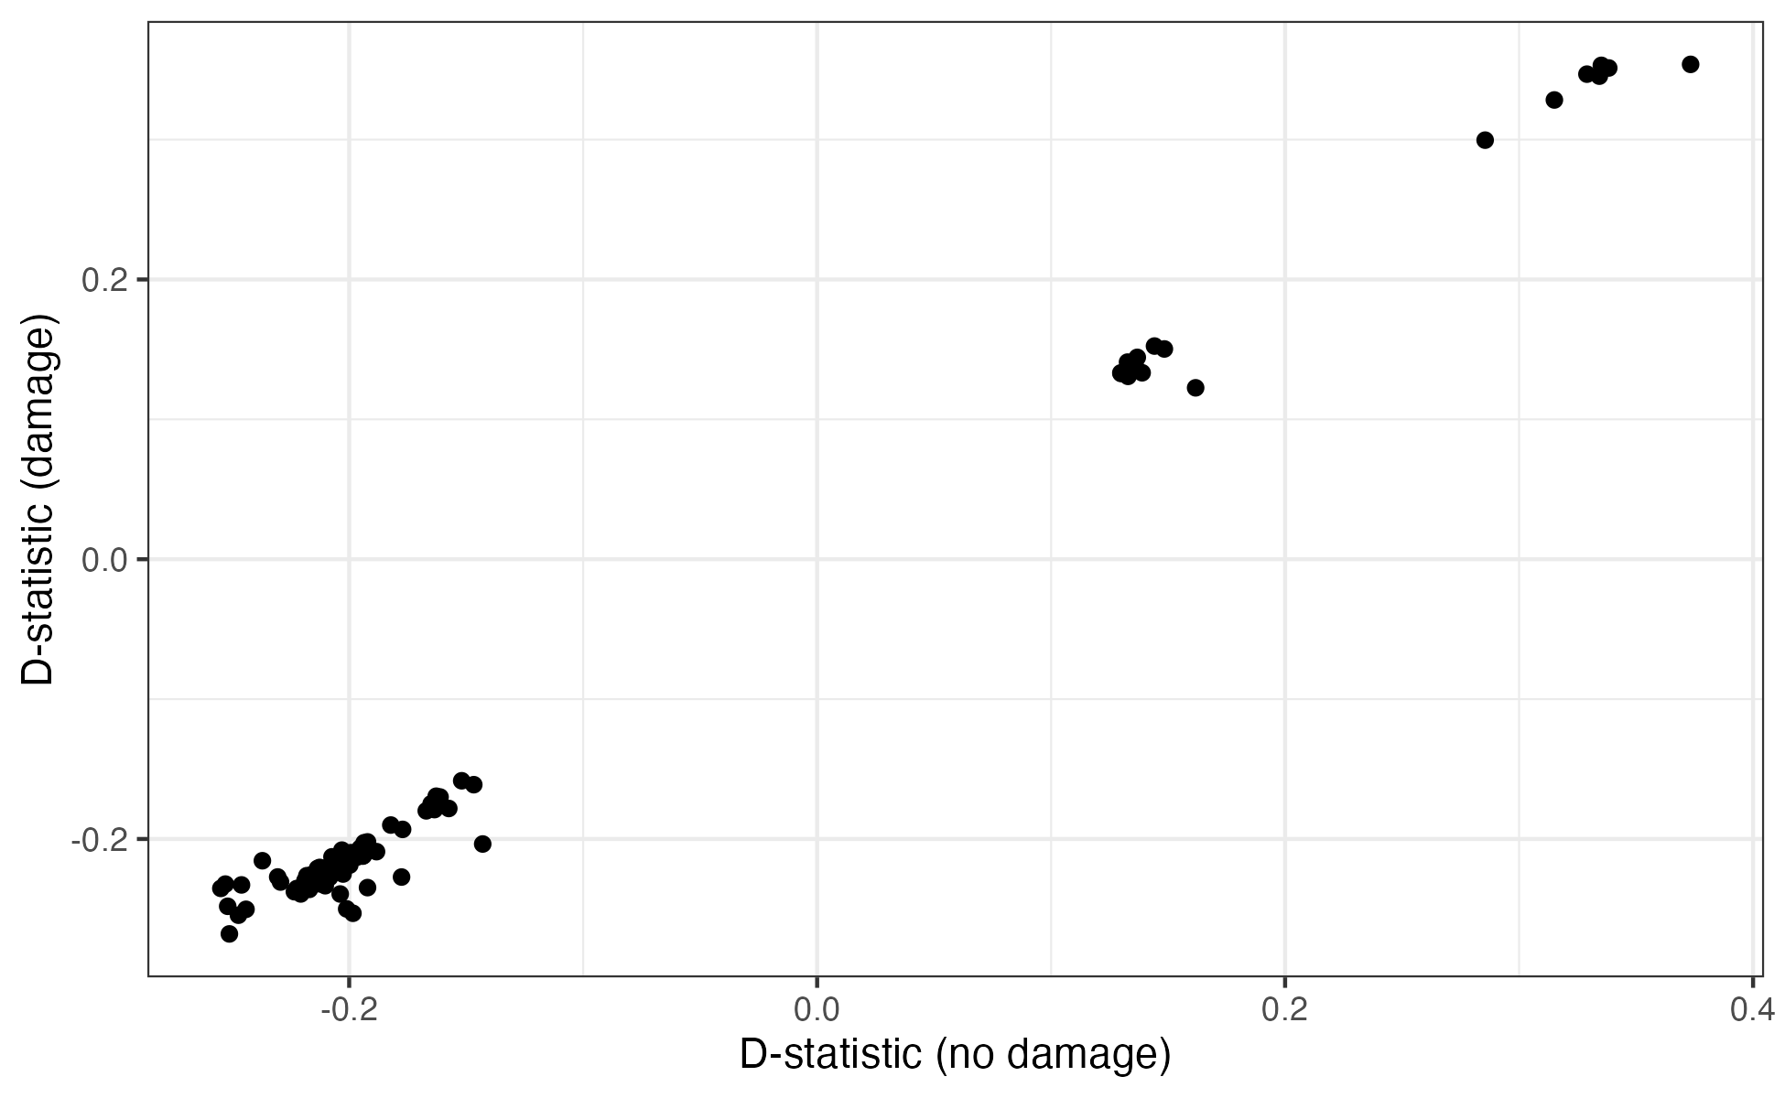
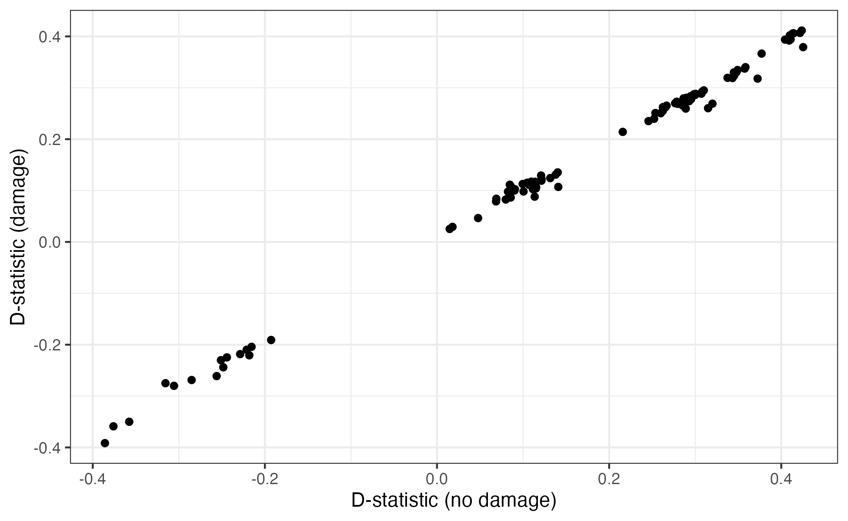
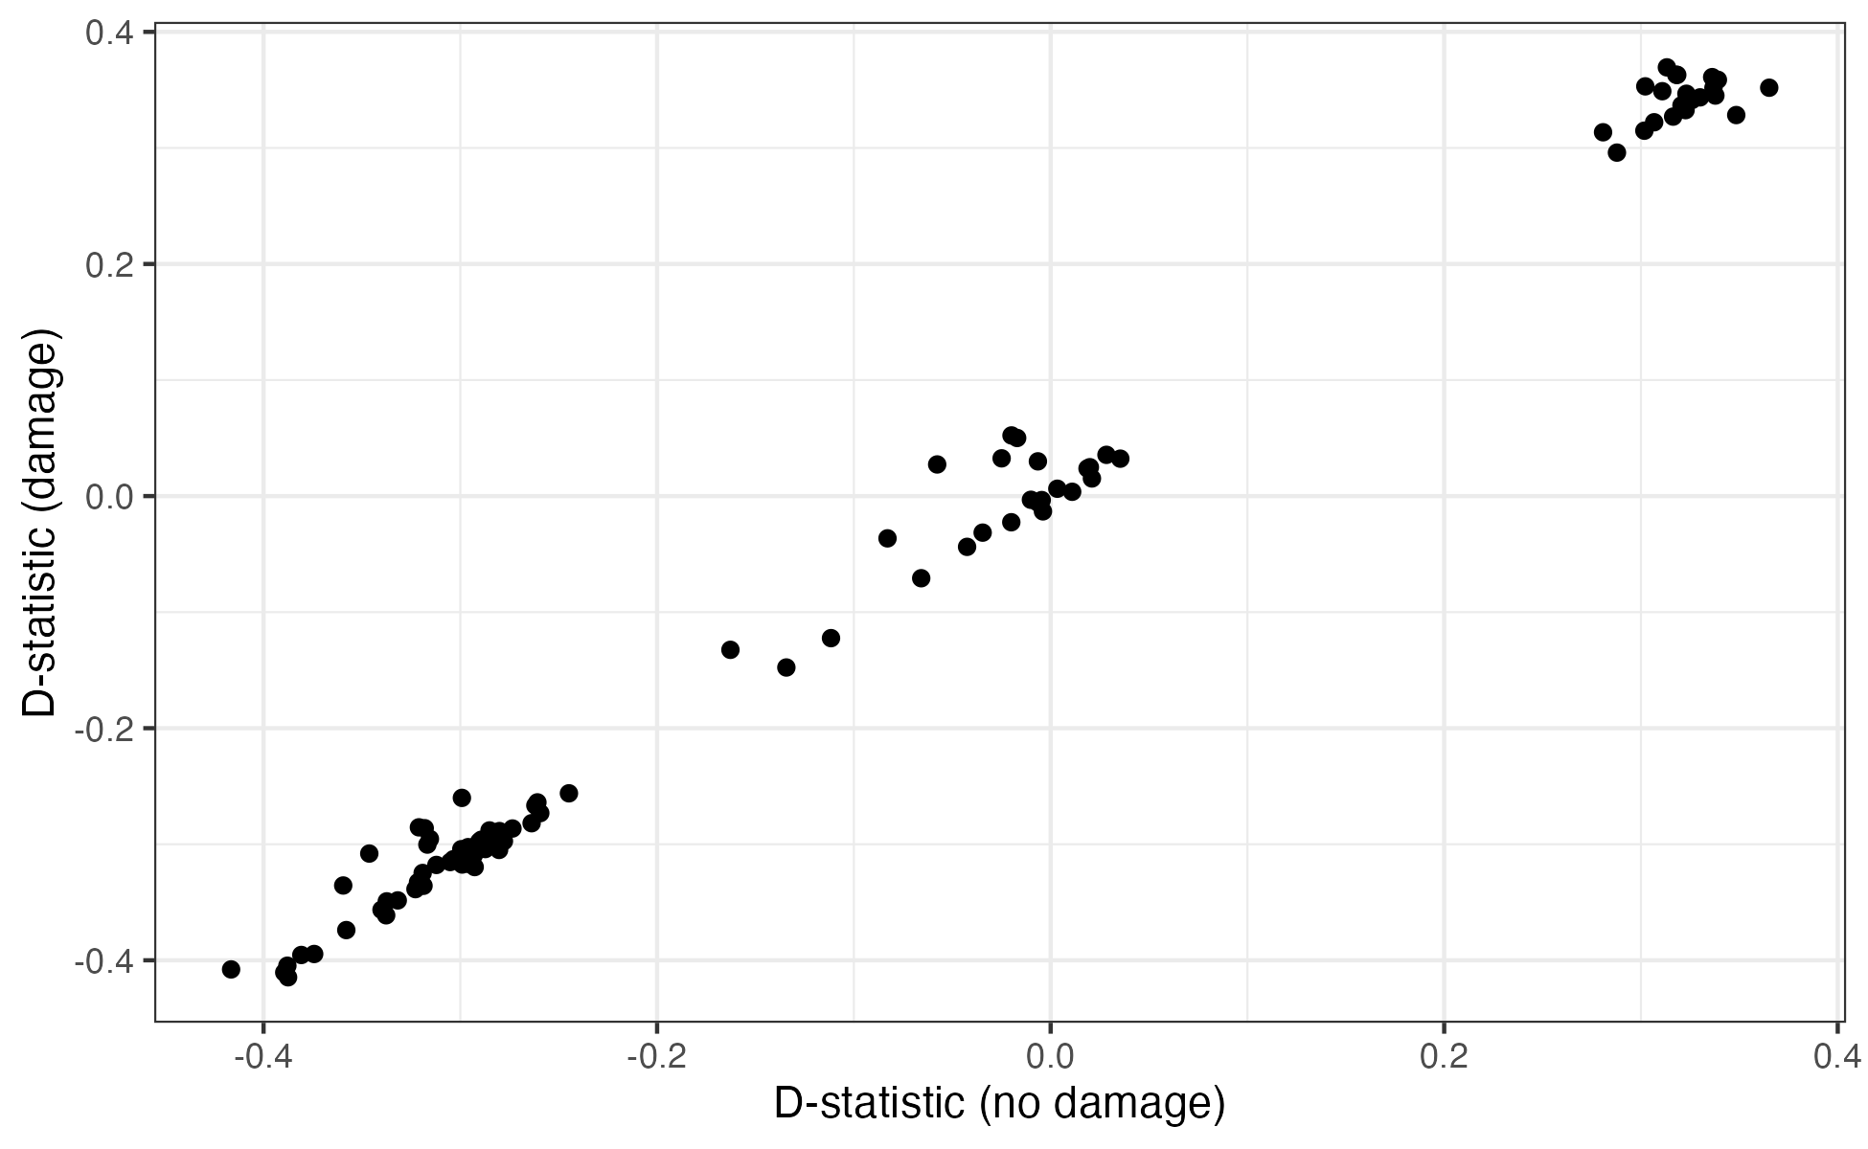
Damaged modern samples
Cacsilensis
Guanaco
Llama

Slide 38
admixture

Slide 39
Theory
Q: What is the most probable source of ancestry, assuming two populations?
1) Population A only
2) Population B only
3) Mixed in Population A and B
Allele frequencies
Solution: Use a Hidden Markov model (HMM), where the emission probabilities of hidden states is determined by the allele frequencies
 | Allele A | Allele G
GUA | 100 | 10
CAC | 10 | 100
Sample | 10 | 1
More likely to be homozygous in GUA than other possibilities

Slide 40

C20 (cluster b)
62 scaffolds joined together
Each ‘bin’ represents 100,000bp, which includes many variants
Ancient vicuña, no evidence of hybridization between guanaco

Slide 41


C21 (cluster A)
Predominantly showing mixed ancestry between guanaco and cacsilensis
(Slightly higher homozygosity in cacsilensis than guanaco!)
No significant presence of vicuña ancestry

Slide 42

C21
Q: Why do we see so much mixed ancestry?
Theory: Hybridization between cacsilensis and guanaco at sample location
Chosen for ritual because of location
Intersection of guanaco and cacsilensis distributions
or
Domesticated attributes, with what we know now about the cacsilensis

Slide 43


C72
Fractured tracts between single ancestry in cacsilensis and mixed ancestry in guanaco and cacsilensis
Some signs of mixed ancestry between guanaco and vicuña, but predominantly homozygous in guanaco

Slide 44
C72
1) Ancient individual from only the cacsilensis distribution, migrated to intersection point
TU-52, TU-85, TU-94
Residential structures
Two theories
Skeletal remains
Plants
2) Now extinct domesticate!
Beads
Shells
Though C72 was obtained from TU-54, perhaps there were settlements for domestication before transportation to sacrifice

Slide 45





Damaged modern samples
Vicuña
Cacsilensis
Guanaco

Slide 46

llama
Allele frequencies
Admixfrog (the admixture tool we used) is more suited towards low coverage data than ADMIXTURE – better to trust Fan et. al, 2020
Uncertainty caused by higher allele frequencies
 | Allele A | Allele G
GUA | 100 | 10
CAC | 10 | 100
Ancient Sample | 3 | 0
Modern Sample | 70 | 30
High probably of GUA
Greater uncertainty

Slide 47
Concluding remarks

Slide 48
Ancient lama populations theories
Multiple domestication sites?
Hybridization between guanacos and cacsilenses
Llama domesticated from cacsilensis

Slide 49




Further comments and limitations
You’ve been a lovely audience
mitochondrial DNA
Impact of ancient DNA damage
Phylogeny from mtDNA vs nDNA
Modern sample relationships
Acknowledgements
Can avoid erroneous results from relatively high coverage samples
Topology majorly impacted by gene flow and permutation of parental mating
Further suggestion of modern domesticate introgression
Asst. Prof. Michael Vincent Westbury
Lorenzen Lab
Center for Health Data Science
Simple answer: more samples needed!*
Unable to make any conclusions about alpaca ancestry
Only one sample for the proposed extinct domesticate population
In memoriam
All the brave camelids who were sacrificed to keep the Gods happy
Removed 65% of ancient samples due to low coverage
*or hope the Hadron Collider becomes a functional time machine

Slide 50
Also I work in the sandbox
Some tidying up before I leave in two weeks (pause for tears* from colleagues)
Updating GWAS webpage to match template
Make amendments to synthetic data generation workflow
*of joy

Slide 51

Synthetic data – privacy metrics
CSS Dataset
EHR Benchmark hard-coded metrics

Slide 52
Synthetic data – privacy metrics
Training Set
Sample 1
Sample 2
Sample 3
Sample 4
Sample 5
Sample 6
Synthetic Set
Sample 1
Sample 2
Sample 3
Sample 4
Sample 5
Sample 6
Nearest neighbour adversarial accuracy (NNAA) risk
Aim: Test for overfitting from the training set
Problem: Very poor results for the Gaussian Copula and ‘Fast ML’ methods – might be better for GANS, from the results of the paper
Good: If Sample 1 closer to any sample in Training Set than any sample in Synthetic Set
Overfitting: If Sample 1 closer to a sample in Synthetic Set than any in Training Set
Do for all samples, and then for Evaluation Set

Slide 53

Synthetic data – privacy metrics
Hard-coded, quasi-identifiers
Progress: Sad
Meaningful identity disclosure risk
Aim: Detect whether the identity and sensitive attributes of a patient’s record are part of the real dataset
Our implementation (for now): Just look at treatment option per patient

